Slide 1
Tennessee Aviation System Plan & Economic Impact Study
TDOT Aeronautics Division
TASP Advisory Committee Meeting I December 9, 2020

Slide 2
Agenda
Since we last met…
Project Update: Issues
Project Update: Intermodal
Project Update: Airport Roles
Project Update: Existing System Performance
Project Update: Economic Impact Study
Next Steps

Slide 3
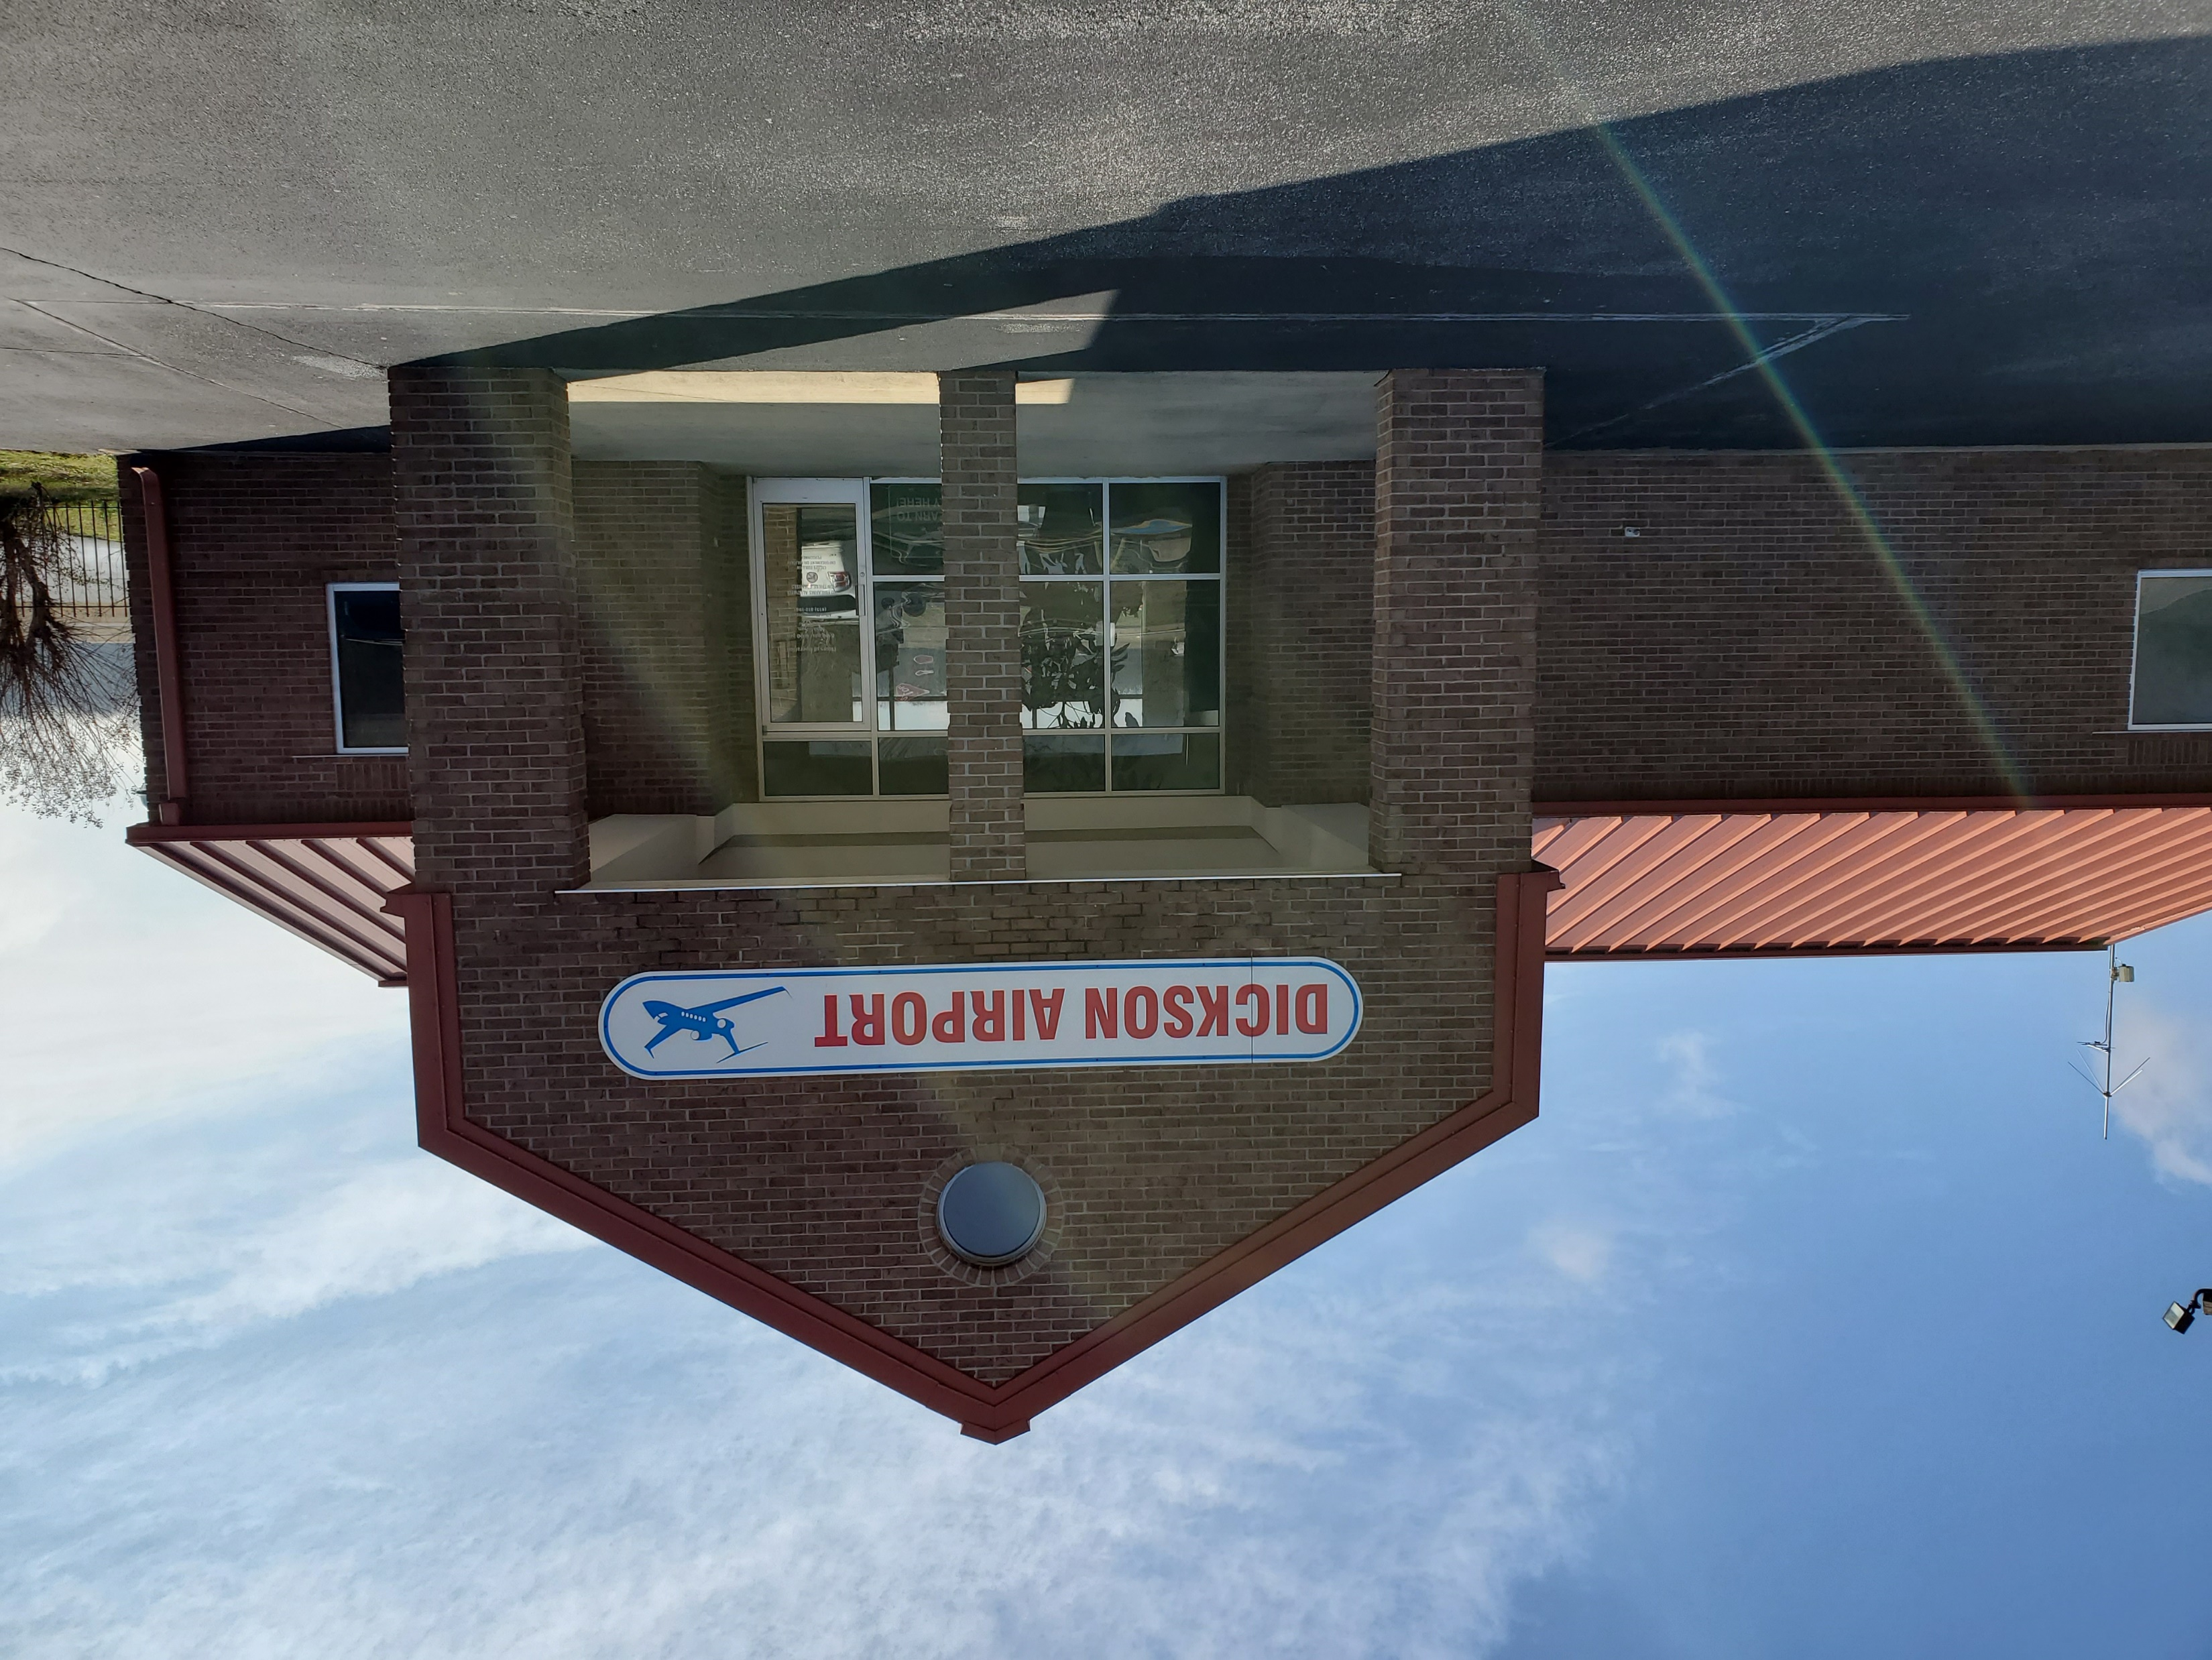
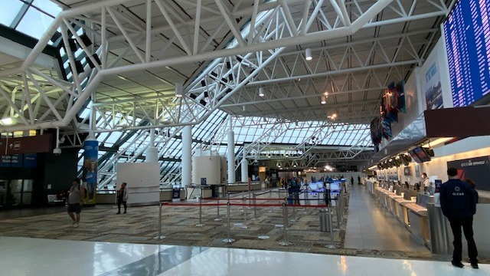
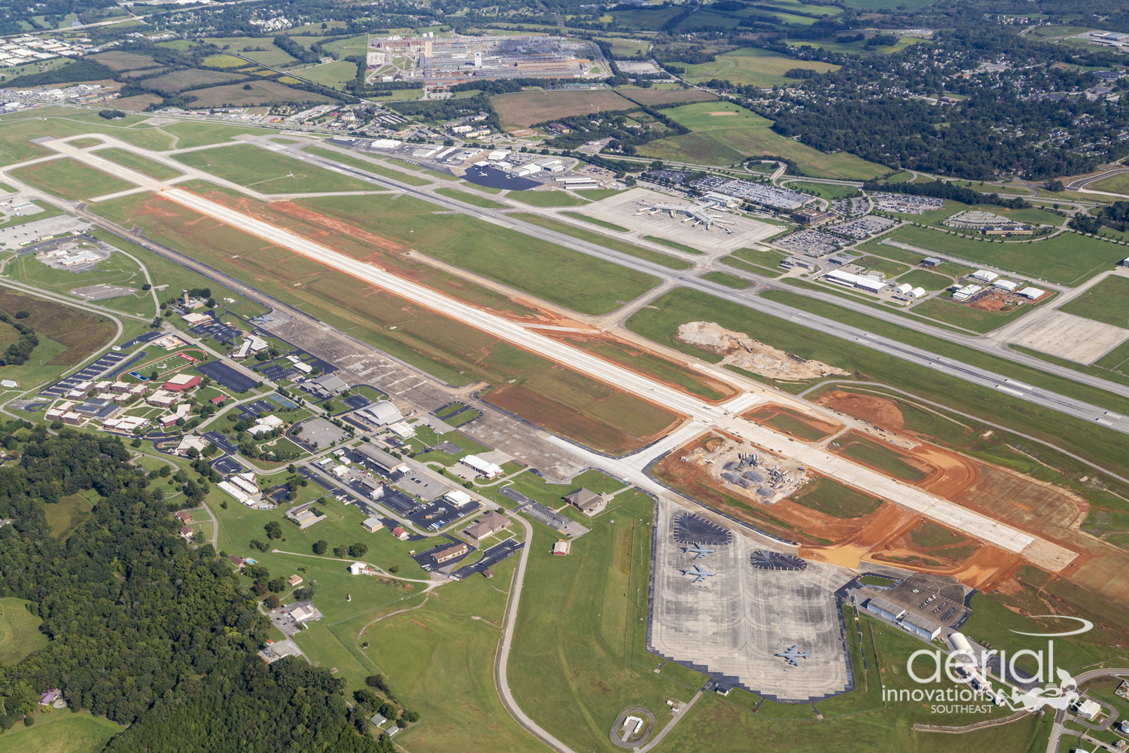
Since we last met…

Slide 4
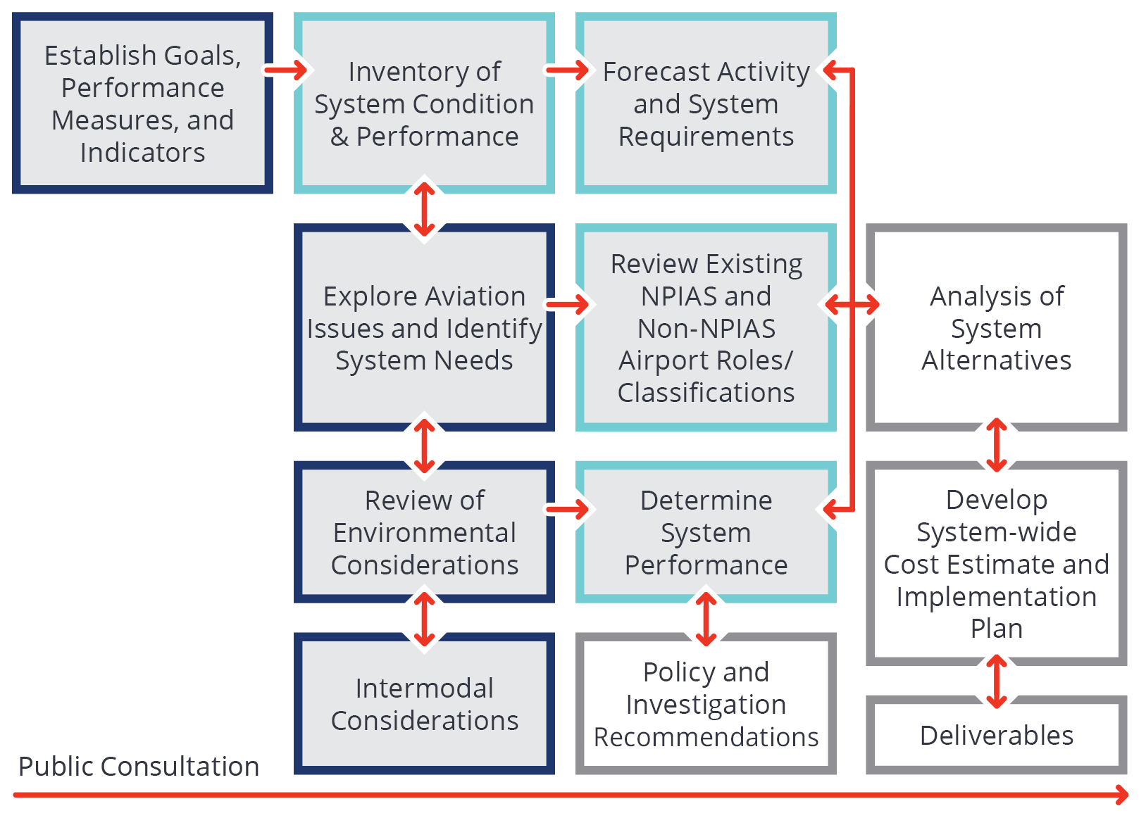
TASP Process
Notes:
The red highlights are the active TASP tasks. The Goals, Issues, Environmental, and Intermodal tasks are complete.

Slide 5
Economic Impact Study Process

Slide 6
Project Update: Issues

Slide 7
Issues Determination
Issues were determined with input from the first AC meeting, manager’s surveys, and discussions with TDOT
Issues that were most frequently mentioned or had the largest impact on Tennessee’s aviation system were selected
The analysis of Issues relied on input from airport managers, industry research, recent news, and data provided by TDOT

Slide 8
Issues
Change to State Fuel Tax
Hangar Availability
Population Growth
Promotion and Marketing
Competition
Industry Concentration
Consumer Expectations
Infrastructure Needs
Technology
Funding
Natural Disasters
Urban Growth
Future Aircraft and Fuel Sources
Pandemics
Workforce

Slide 9
Issues Findings
Funding
Infrastructure Needs
Urban Growth
More projects are in ACIPs than can be funded. Projects must be planned, programmed, and executed to ensure that the system remains safe, operational, and financially viable.
Tennessee is anticipated to experience increasing air travel demands which will impact the facilities and services currently provided at airports.
Increased urbanization may encroach upon airports and reduce their capacity to develop, limiting their ability to meet growing demand.
DISCUSS
Notes:
Update to include major findings from each section

Slide 10
Project Update: Intermodal

Slide 11
Intermodal Integration and Airport Access
Airport roadway connections
Intermodal integration
Tennessee’s freight network
Transportation areas of concern
State and regional planned transportation improvements
What Was Evaluated?
DISCUSS
Intermodal access is crucial to the development of the state
Planning for future intermodal access
Why Is It Important?

Slide 12
Intermodal Integration
Percent of Airports With…
Courtesy Cars | 95%
Rental Car Availability | 81%
Rideshare (Uber or Lyft) | 62%
Taxis | 58%
Public Transportation (On-Demand Bus) | 21%
Shuttle Services | 19%
Public Transportation (Bus) | 10%

Slide 13
Intermodal Integration

Slide 14
Project Update: Airport Roles

Slide 15
Airport Roles Determination
Reviewed latest NPIAS (2021-2025) and multiple state airport classification methodologies
Developed objectives for TASP Airport Role classification:
Data driven
Updatable
Simple
Right-size facilities
Fill potential gaps in the system

Slide 16
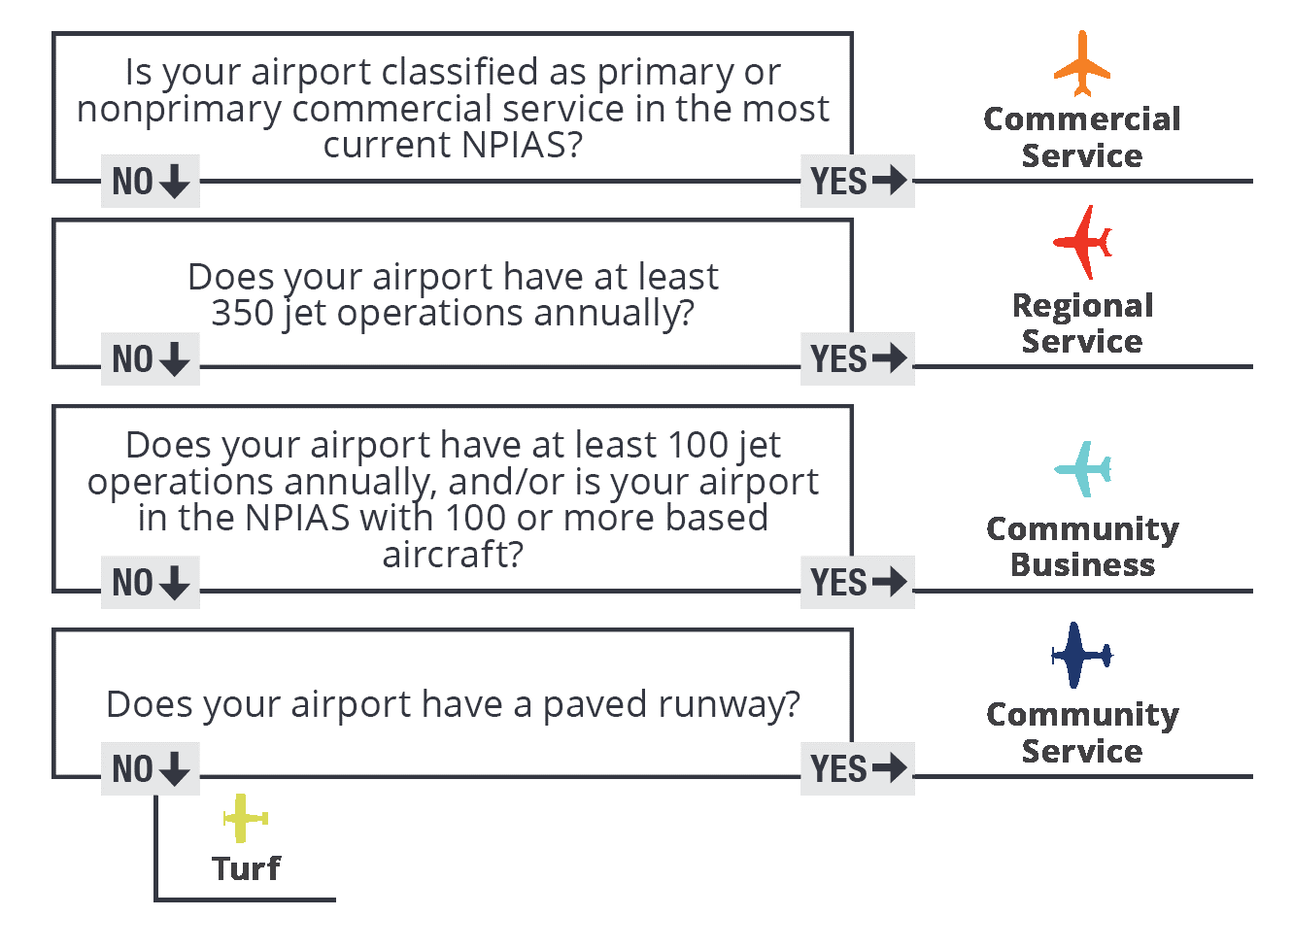
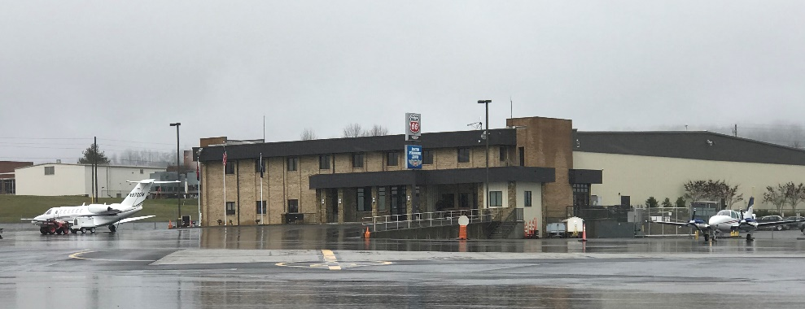
Classifying Airports

Slide 17
Proposed 2020 State Airport System
State Role | Number of Airports
Commercial Service | 6
Regional Service | 17
Community Business | 15
Community Service | 38
Turf | 2
Total | 78

Slide 18
Roles Timeline and Comments
TDOT presented findings to the Commissioner on September 30th
TDOT presented findings to the TAC on October 5th
Project team presented to the AC on November 9th
Comments so far:
Refine definition of jet operations
Edit definition of Regional Service Airports
DISCUSS
Notes:
Thank you to Dan Cogan for your feedback about the Roles chapter, particularly about the comparison of roles with other states

Slide 19
Project Update: Existing System Performance

Slide 20
Existing System Performance
Existing system performance is determined by evaluating Performance Measures (PMs), System Indicators (SIs), Supporting Data, and Facility and Service Objectives (FSOs)
PMs, SIs, Supporting Data, and FSOs are evaluated using data collected during the inventory process
Existing system performance helps TDOT understand how the system is meeting TASP Goals
Gaps in existing system performance help inform future project recommendations

Slide 21
Goals
Goal #1 – Preserve Airport Infrastructure: Protect and preserve existing airport infrastructure by prioritizing airport system needs.
Goal #2 – Transportation Options: Provide an airport system with available and cost-efficient transportation options for moving people and freight.
Goal #3 – Safety and Security: Improve the safety and security of airport system users.
Goal #4 – Funding and Environment: Maximize federal, state, and local resources to meet airport system needs and minimize environmental impacts.
Goal #5 – Workforce and Economy: Invest in the airport system and aviation workforce to support economic growth and competitiveness.

Slide 22
PMs, SIs, and Supporting Data by Goal
Goal | PMs | SIs | Supporting Data
Preserve Airport Infrastructure | 2 | 10 | 2
Transportation Options | 2 | 12 | 0
Safety and Security | 3 | 13 | 3
Funding and Environment | 4 | 11 | 2
Workforce and Economy | 1 | 12 | 2
Notes:
Goal 1 example PM: Percent of airports meeting the airport pavement management system (APMS) objective
Goal 2 example PM: Percent of area and population within a 45-minute drive to any Tennessee commercial service airport
Goal 3 example PM: Percent of airports that have adopted an emergency response and/or security plan (on next slide)
Goal 4 example PM: Percent of airports with airport included in local comprehensive and/or land use plan
Goal 5 example PM: Population and area within a 45-minute drive time of an airport meeting business aircraft needs (this is the sole PM)

Slide 23
Existing System Performance Example
Goal #1 – Preserve Airport Infrastructure: Protect and preserve existing airport infrastructure by prioritizing airport system needs.
Performance Measure: Percent of airports meeting the airport pavement management system (APMS) objective – Runways > 65

Slide 24
Existing System Performance Example
Goal #3 – Safety and Security: Improve the safety and security of airport system users.
Performance Measure: Percent of airports that have adopted an emergency response and/or security plan

Slide 25
Existing System Performance Results
The Existing System Performance Chapter is combined with the Inventory Chapter to present results in a cohesive narrative
Results of Existing System Performance are organized by Goal
Results of the Inventory effort are presented in tables at the end of the Chapter
Gaps or deficiencies will be reflected in future recommendations

Slide 26
Project Update: Economic Impact Study

Slide 27
Economic Impact Study Progress
Data collection is complete, including airport manager’s surveys, tenants, and commercial service passenger surveys
Surveying completed at BNA, MEM, TYS, CHA, and TRI
Preliminary results for on-airport impacts, visitor spending impacts, and air cargo impacts
Tax impacts are currently being developed

Slide 28
Preliminary Findings
Economic Impact Information Summary
Airport Employees | 1,250
Airport Business Tenants | 443
Airport Business Tenant Employees | 31,640
Commercial Service Passenger Surveys | 2,418

Slide 29
Statewide Air Cargo Findings
Impact | Jobs | Labor Income (Millions of $) | Value Added (Millions of $) | Business Revenues (Millions of $)
Direct | 35,556 | $2,728 | $4,505 | $11,437
Supplier Sales | 23,223 | $1,439 | $2,185 | $4,281
Income Respending | 23,579 | $1,253 | $2,081 | $3,574
Total | 82,357 | $5,420 | $8,771 | $19,292

Slide 30
Next Steps

Slide 31
Questions?
Evan Lester
TDOT Aeronautics Division Project Manager
615.361.8016
Evan.Lester@tn.gov
Zach DeVeau
Kimley-Horn Project Manager
850.553.3530
Zach.DeVeau@kimley-horn.com

