Slide 1
Tennessee Aviation System Plan & Economic Impact Study
TDOT Aeronautics Division
TASP Advisory Committee Meeting I March 25, 2021

Slide 2
Agenda
Since we last met…
Project Update: Economic Impact Study
Project Update: Existing System Performance and Future System Performance
Next Steps

Slide 3
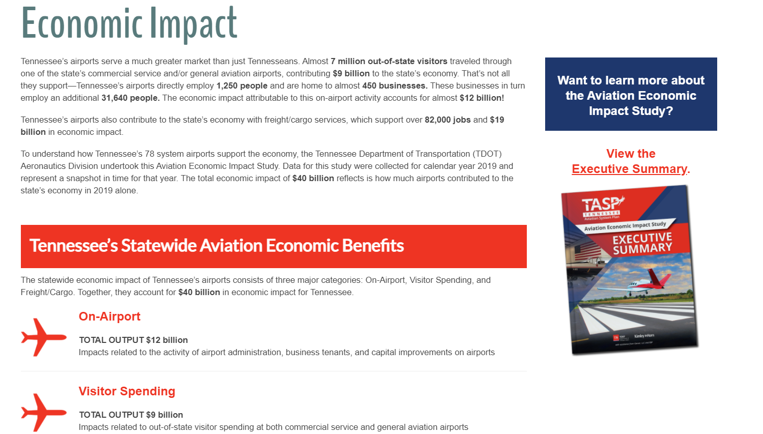
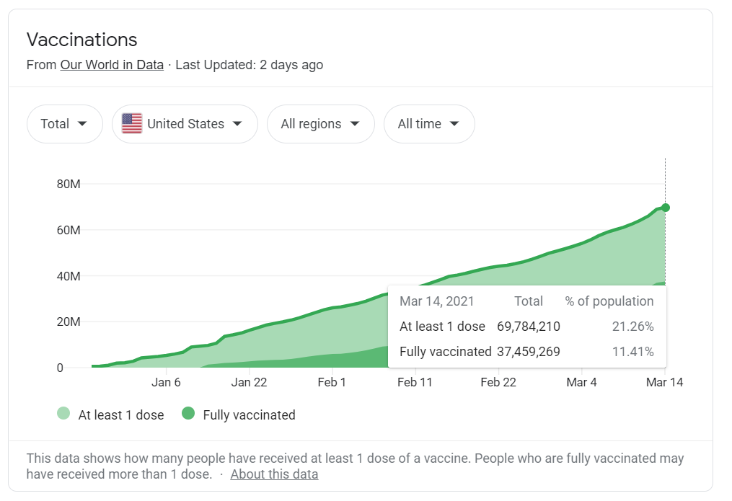
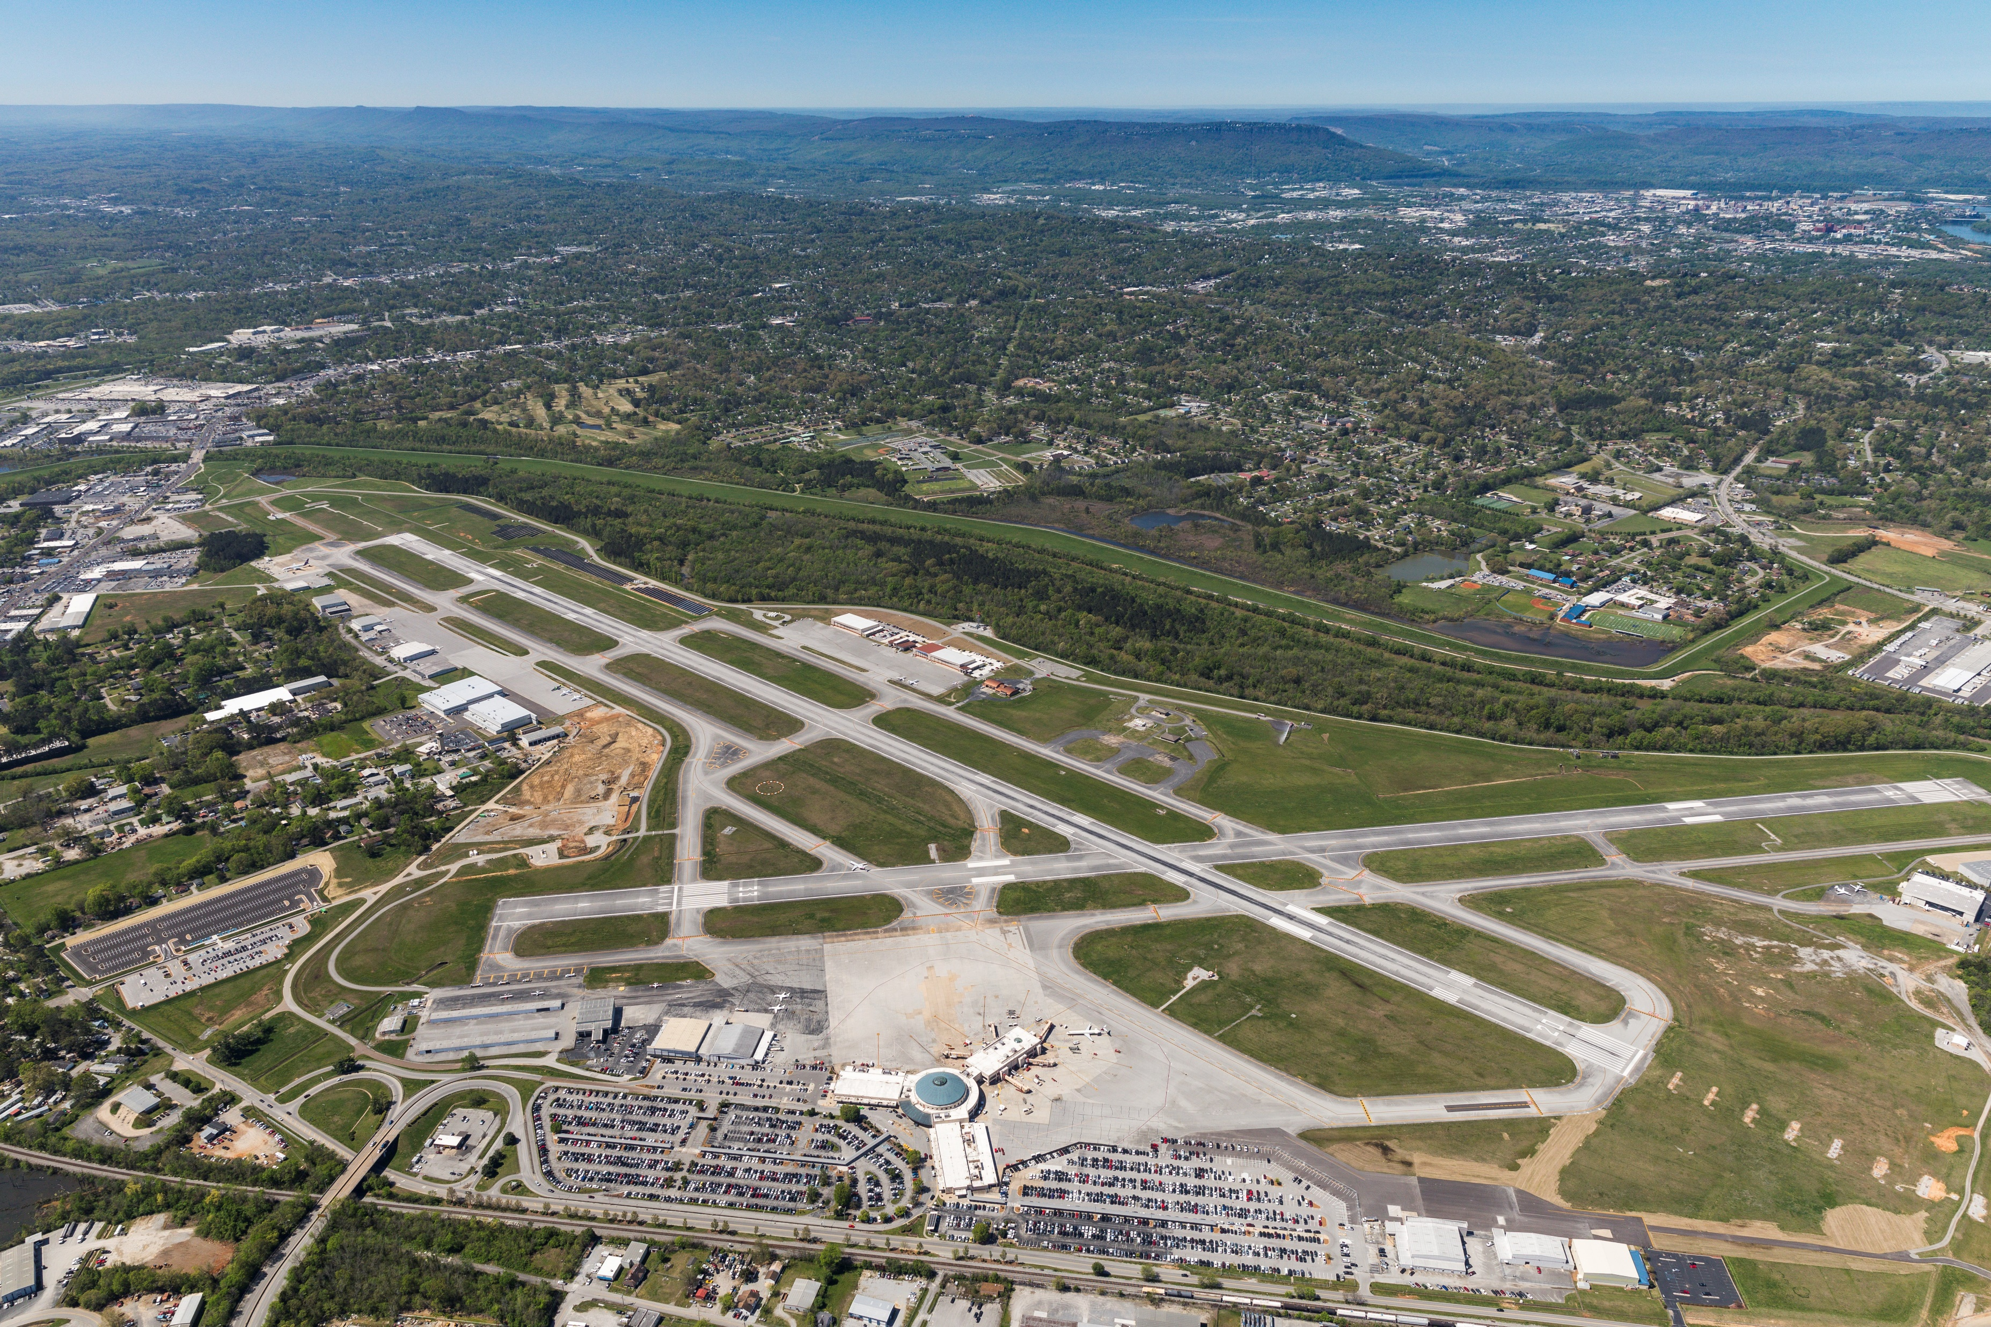
Since we last met…

Slide 4
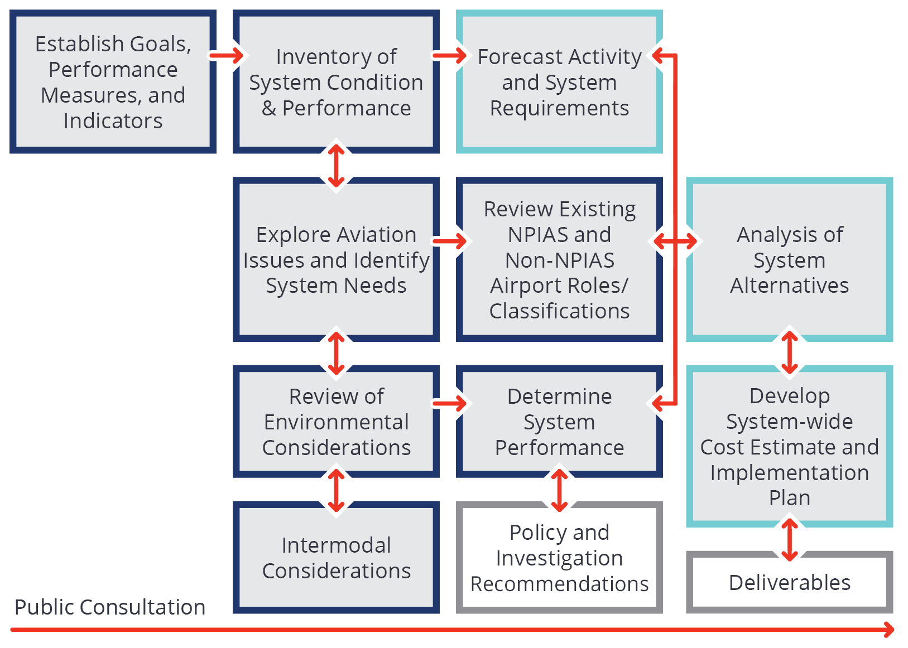
TASP Process

Slide 5
Economic Impact Study Process

Slide 6
Project Update: Economic Impact Study

Slide 7
Statewide Aviation Economic Impact Study Findings

Slide 8
Statewide Aviation Economic Impact Study Findings
Notes:
The off-airport air cargo analysis assesses the reliance of off-airport industries in Tennessee on cargo that is transported through Tennessee airports and calculates the economic contributions of this air cargo to off-airport businesses on both the statewide and regional bases. This analysis does not include the impacts of on-airport air cargo jobs, which are covered by other components of the Economic Impact Study. Freight/cargo impacts also do not include pass-through cargo that does not interact with Tennessee’s economy

Slide 9
Statewide Aviation Economic Impact Study Findings

Slide 10
Region 1 Impacts

Slide 11
Region 2 Impacts

Slide 12
Region 3 Impacts

Slide 13
Region 4 Impacts

Slide 14
Economic Impact Study Executive Summary Brochure

Slide 15
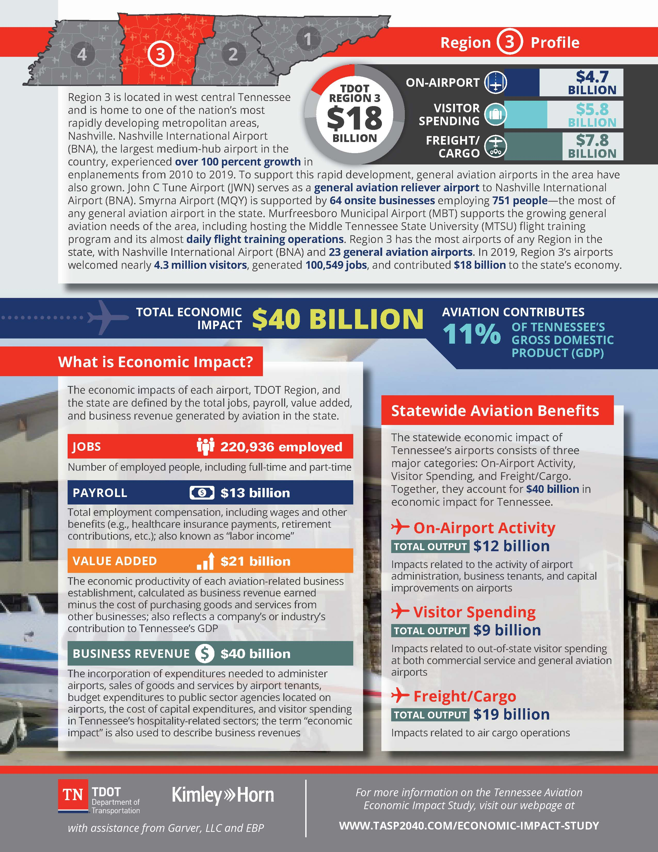
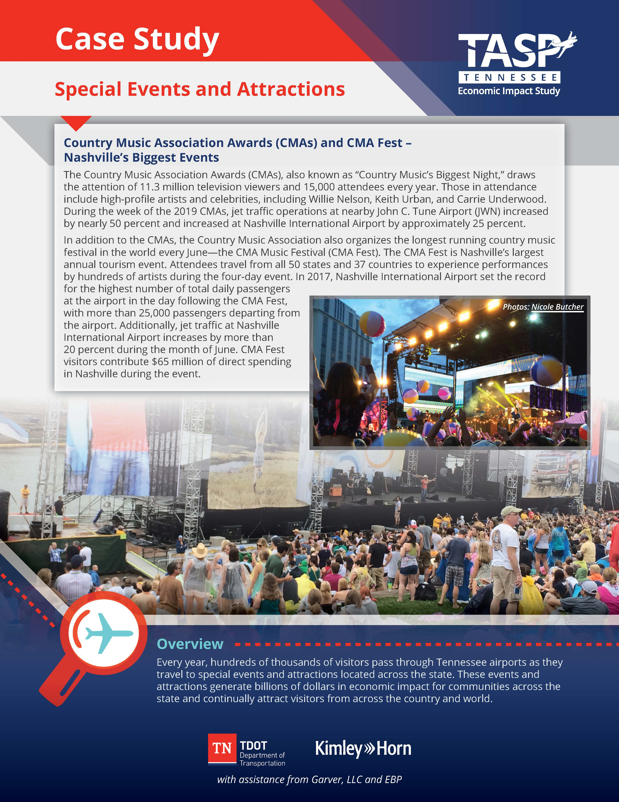
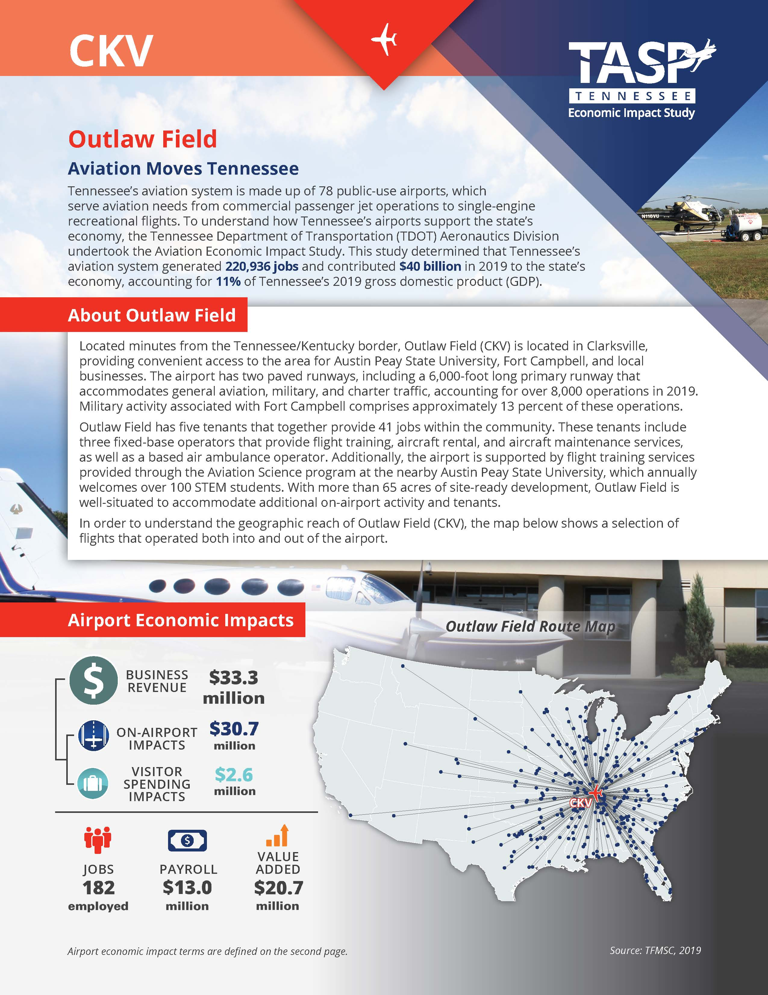
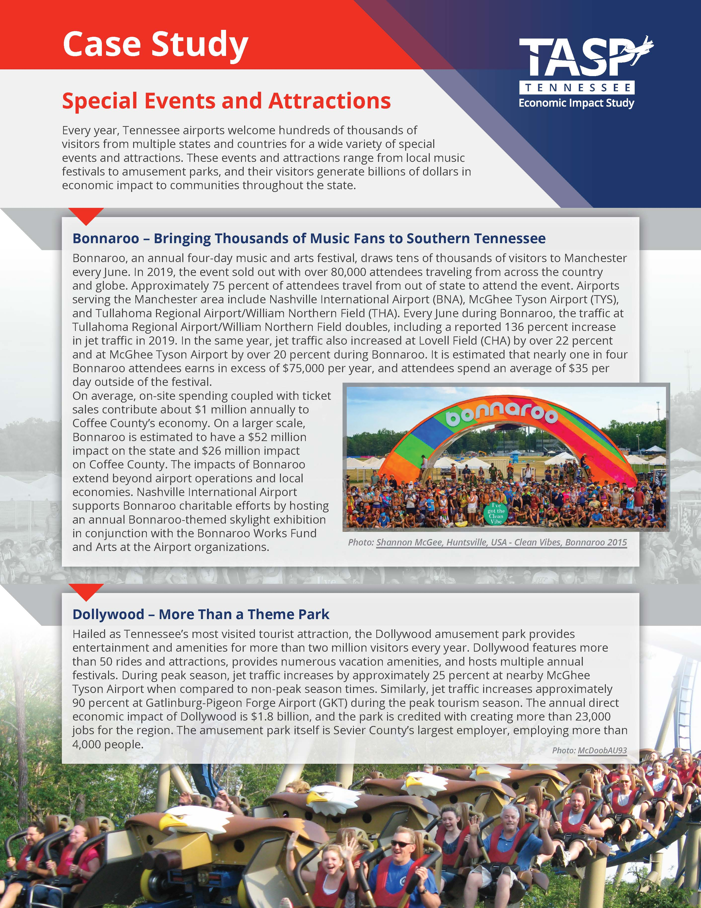
Other Deliverables
tasp2040.com/economic-impact-study

Slide 16
Project Update: Existing System Performance and Future System Performance

Slide 17
Existing System Performance
Determined by evaluating Performance Measures (PMs), System Indicators (SIs), and Facility and Service Objectives (FSOs)
Evaluated using data collected during the inventory process
The existing system performance helps TDOT understand how the system is meeting TASP Goals
Seeing gaps in existing system performance helps inform project recommendations

Slide 18
Future System Performance
Determined by evaluating PMs against future performance targets
Mapping analysis PMs rely on gap analysis to determine future system performance
Most future performance targets aim to have all airports meet the performance measure
Airports that do not meet future performance targets will have a suggested project covered in the Cost Estimates task

Slide 19
Goals
Goal #1 – Preserve Airport Infrastructure: Protect and preserve existing airport infrastructure by prioritizing airport system needs.
Goal #2 – Transportation Options: Provide an airport system with available and cost-efficient transportation options for moving people and freight.
Goal #3 – Safety and Security: Improve the safety and security of airport system users.
Goal #4 – Funding and Environment: Maximize federal, state, and local resources to meet airport system needs and minimize environmental impacts.
Goal #5 – Workforce and Economy: Invest in the airport system and aviation workforce to support economic growth and competitiveness.

Slide 20
PMs, SIs, and Supporting Data by Goal
Goal | PMs | SIs | Supporting Data
Preserve Airport Infrastructure | 2 | 10 | 2
Transportation Options | 2 | 12 | 0
Safety and Security | 3 | 13 | 3
Funding and Environment | 4 | 11 | 2
Workforce and Economy | 1 | 12 | 2

Slide 21
Goal #1 Performance Measure Example
Goal #1 – Preserve Airport Infrastructure: Protect and preserve existing airport infrastructure by prioritizing airport system needs.
Performance Measure: Percent of airports meeting the airport pavement management system (APMS) objective – Runways > 65

Slide 22
Goal #1 Future System Performance Example
Goal #1 – Preserve Airport Infrastructure: Protect and preserve existing airport infrastructure by prioritizing airport system needs.
Performance Measure: Percent of airports meeting the airport pavement management system (APMS) objective – Runways > 65
Airport Classification | Current Performance | Future Performance Targets | Airports Needed to Meet Future System Performance
Commercial Service | 4 (67%) | 6 (100%) | 2 (33%)
Regional Service | 12 (71%) | 17 (100%) | 5 (29%)
Community Business | 12 (80%) | 15 (100%) | 3 (20%)
Community Service | 26 (66%) | 38 (100%) | 12 (34%)
Turf | N/A | No Target Established | N/A
Statewide | 54 (69%) | 76 (97%)¹ | 22 (28%)

Slide 23
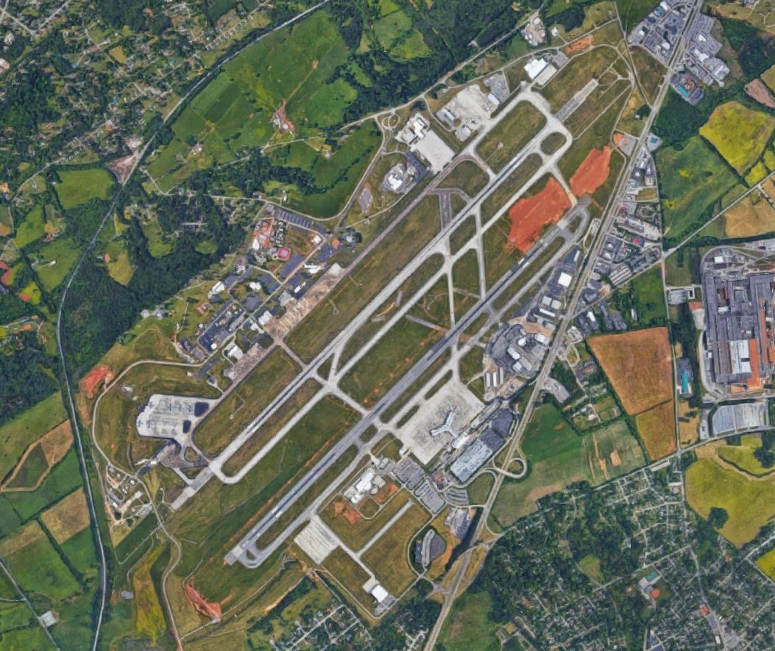
Goal #2 Performance Measure
Goal #2 – Transportation Options: Provide an airport system with available and cost-efficient transportation options for moving people and freight.
Performance Measure: Percent of area and population within a 45-minute drive to any Tennessee commercial service airport.
65 percent of Tennessee’s population
22 percent of Tennessee’s total land area

Slide 24
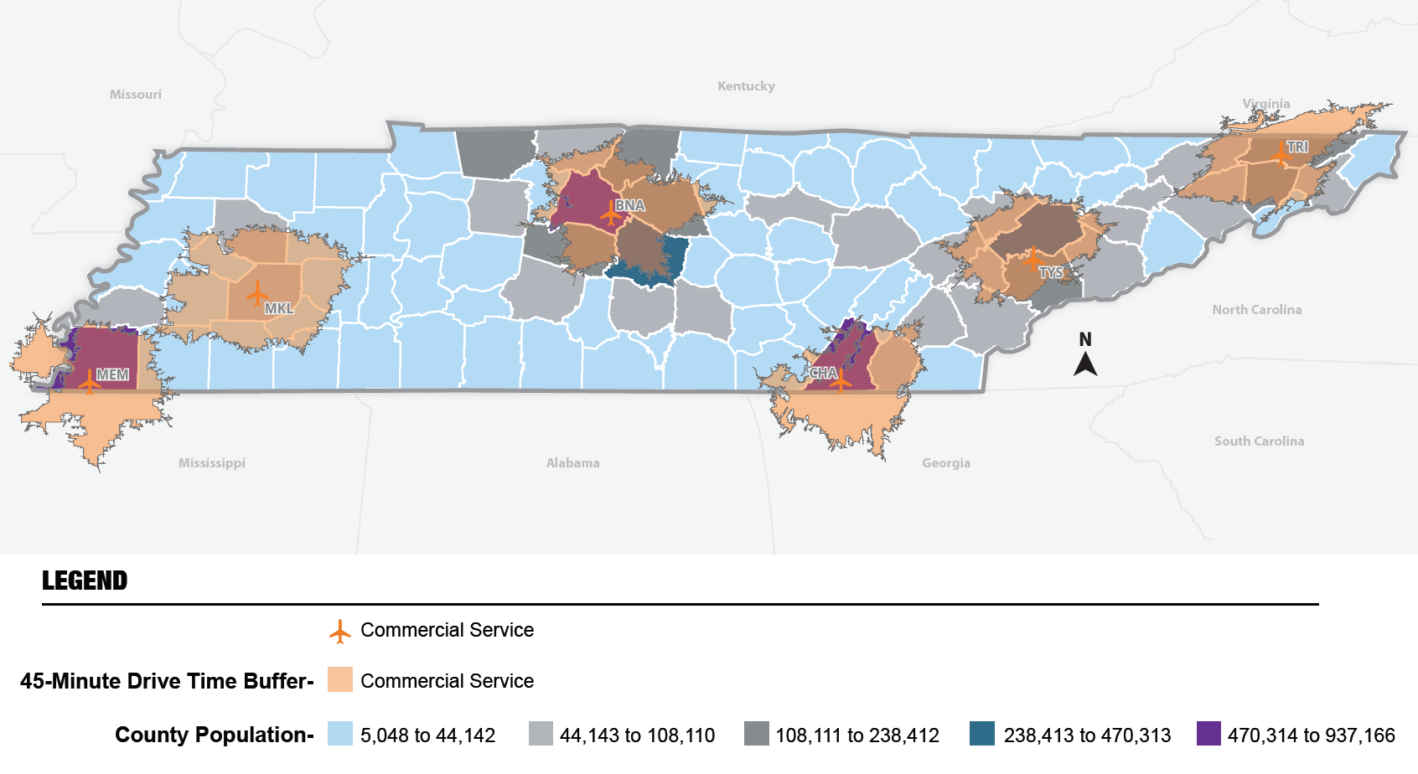
Percent of area and population within a 45-minute drive to any Tennessee commercial service airport

Slide 25
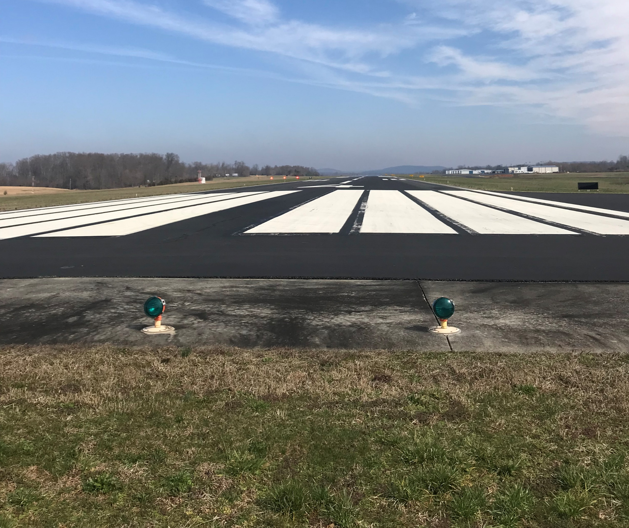
Goal #2 Future System Performance
Goal #2 – Transportation Options: Provide an airport system with available and cost-efficient transportation options for moving people and freight.
Performance Measure: Percent of area and population within a 45-minute drive to any Tennessee commercial service airport.
Additional 1.6 percent of Tennessee’s population
Additional four percent of Tennessee’s total land area

Slide 26
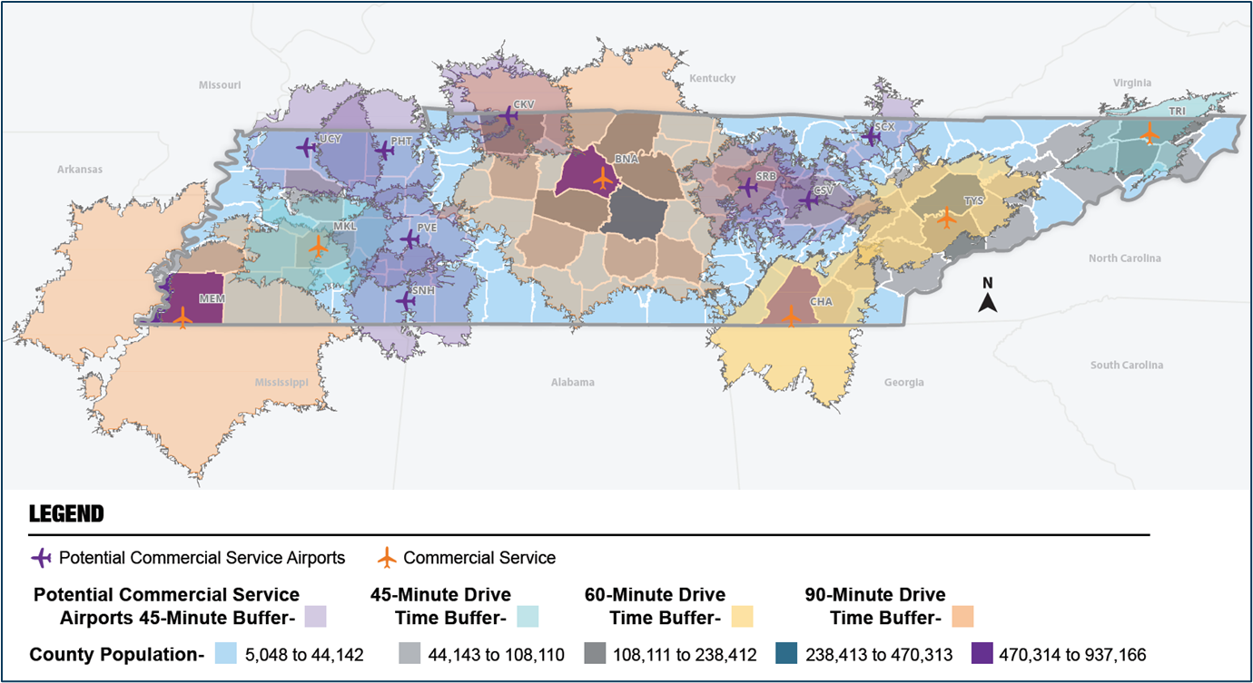
Potential Future Commercial Service Airports

Slide 27
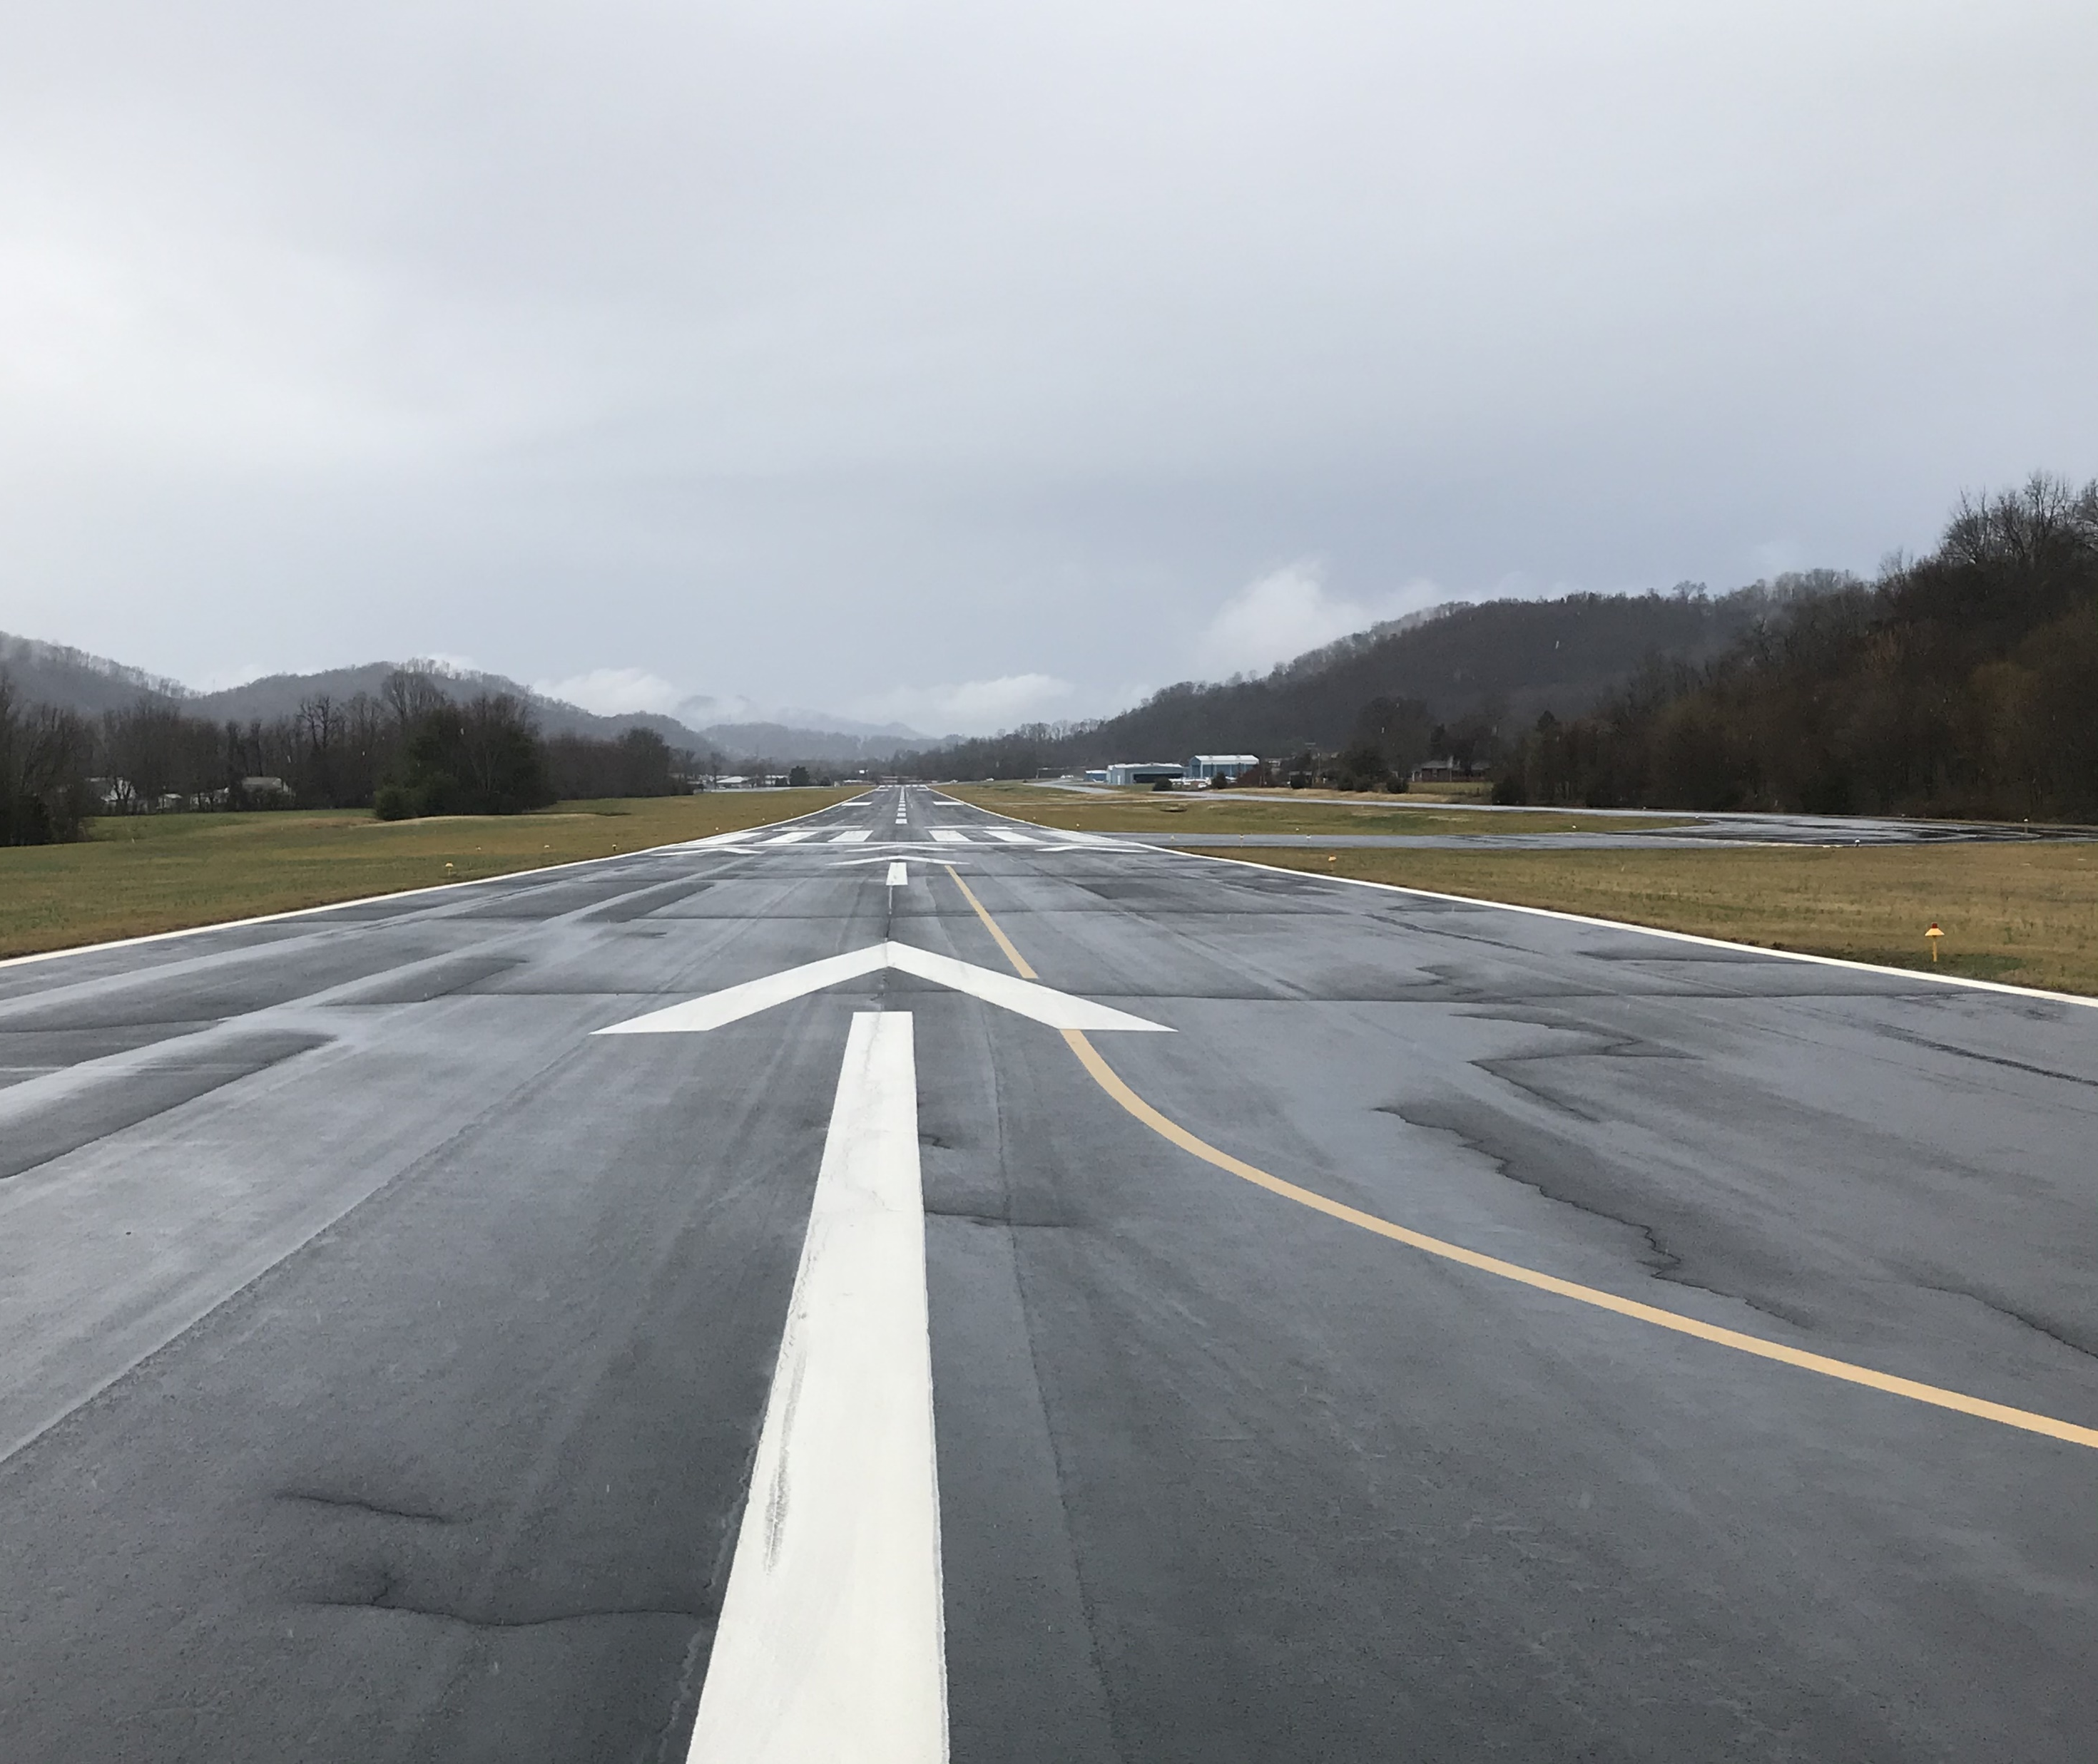
Goal #2 Performance Measure
Goal #2 – Transportation Options: Provide an airport system with available and cost-efficient transportation options for moving people and freight.
Performance Measure: Percent of area and population within a 30-minute drive to any Tennessee general aviation airport
87 percent of Tennessee’s population
71 percent of Tennessee’s total land area

Slide 28
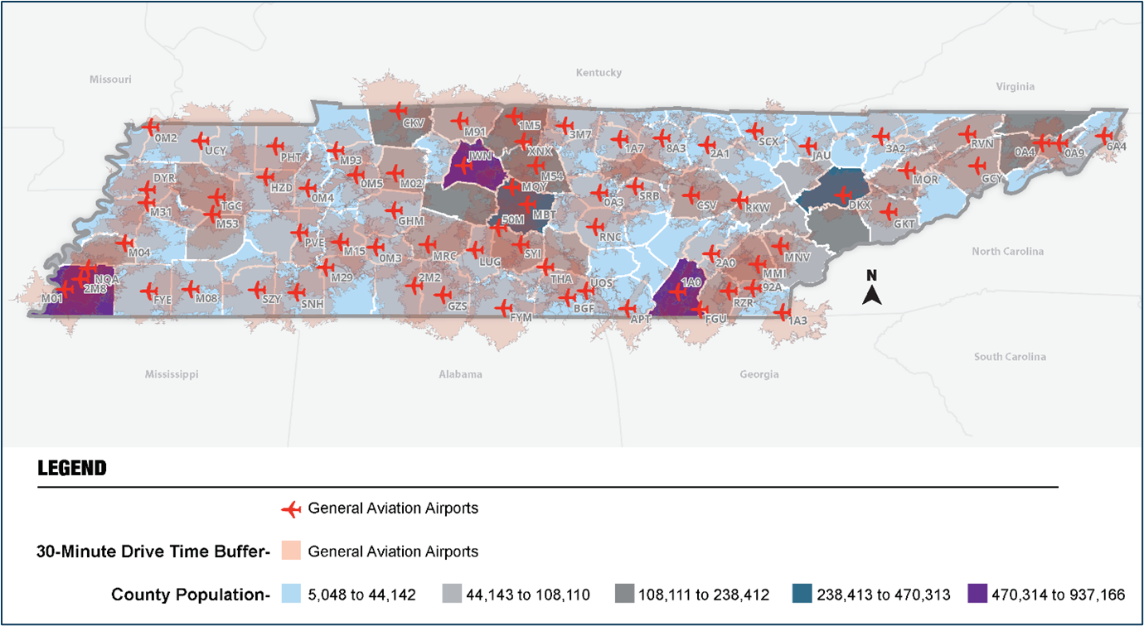
Percent of area and population within a 30-minute drive to any Tennessee general aviation airport

Slide 29
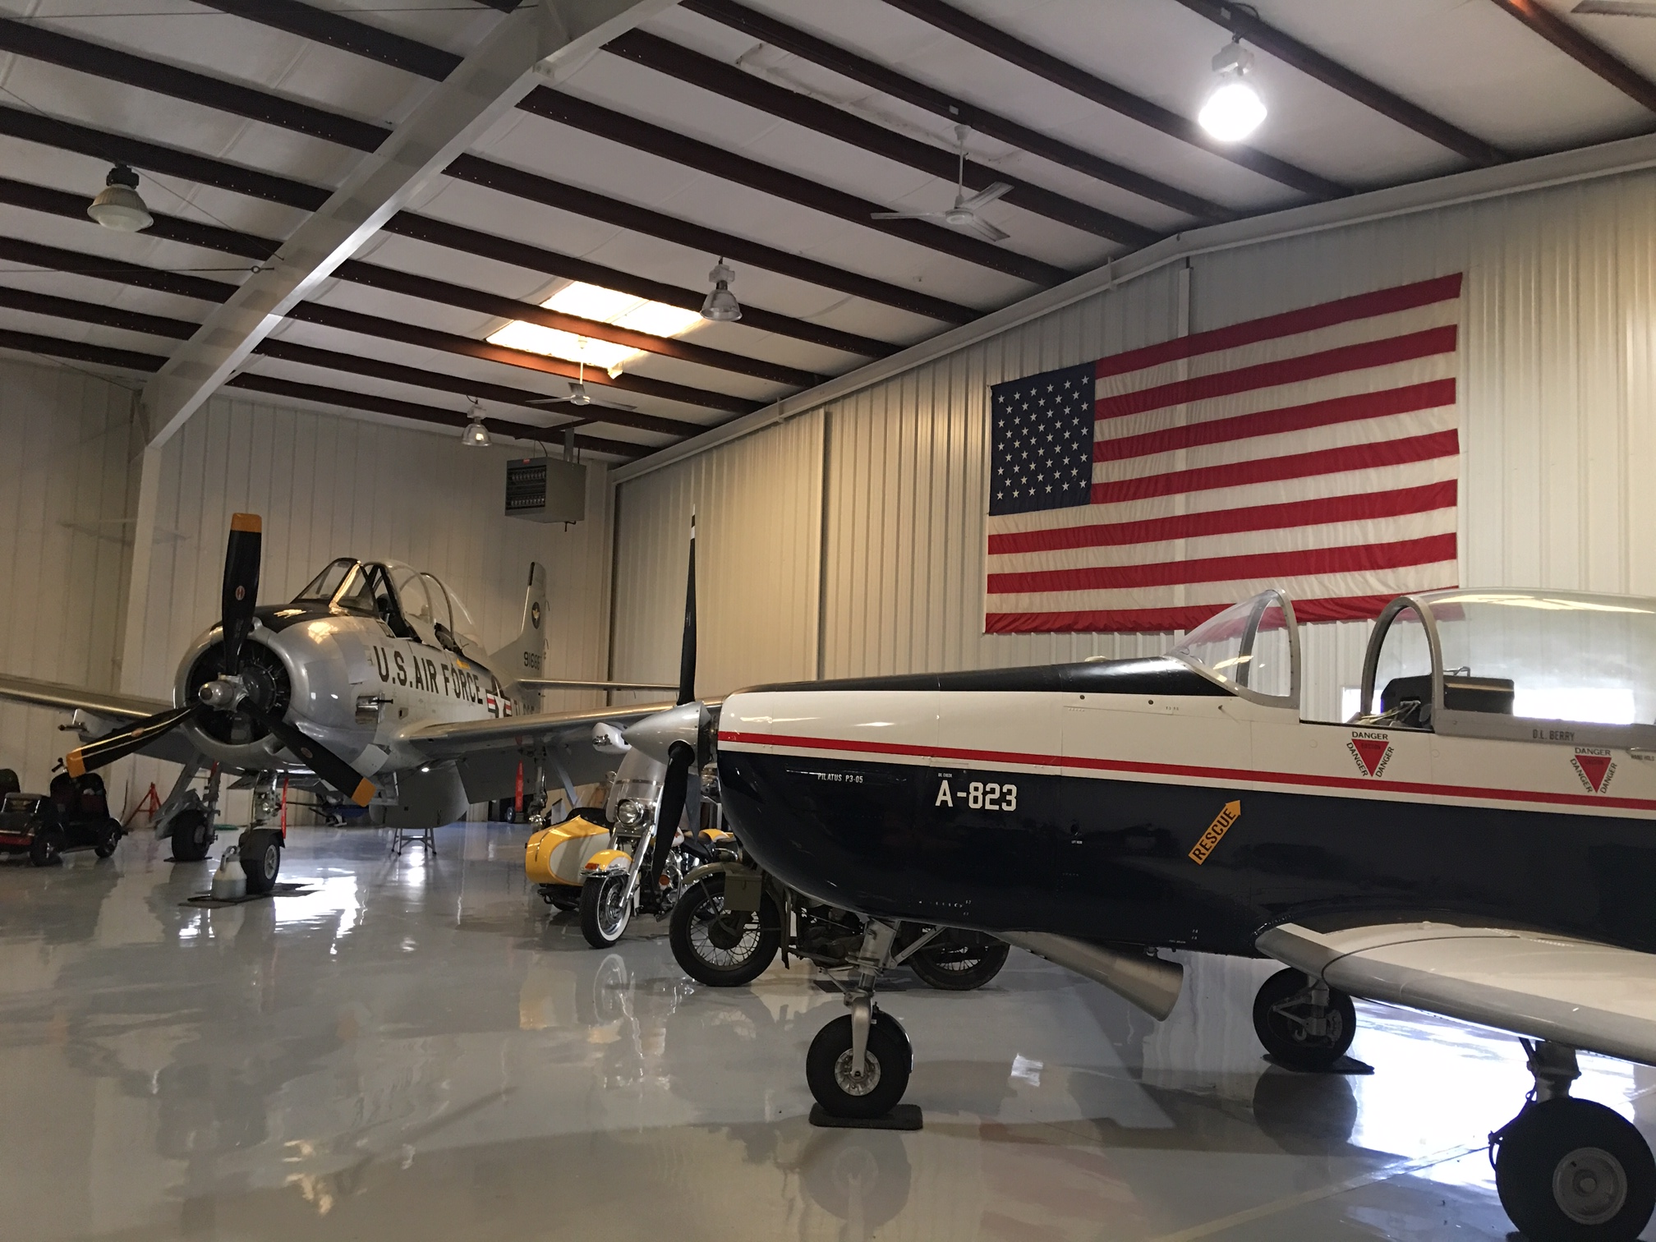
Goal #2 Future System Performance
Goal #2 – Transportation Options: Provide an airport system with available and cost-efficient transportation options for moving people and freight.
Performance Measure: Percent of area and population within a 30-minute drive to any Tennessee general aviation airport
Additional 1.8 percent of Tennessee’s population
Additional 0.4 percent of Tennessee’s total land area

Slide 30
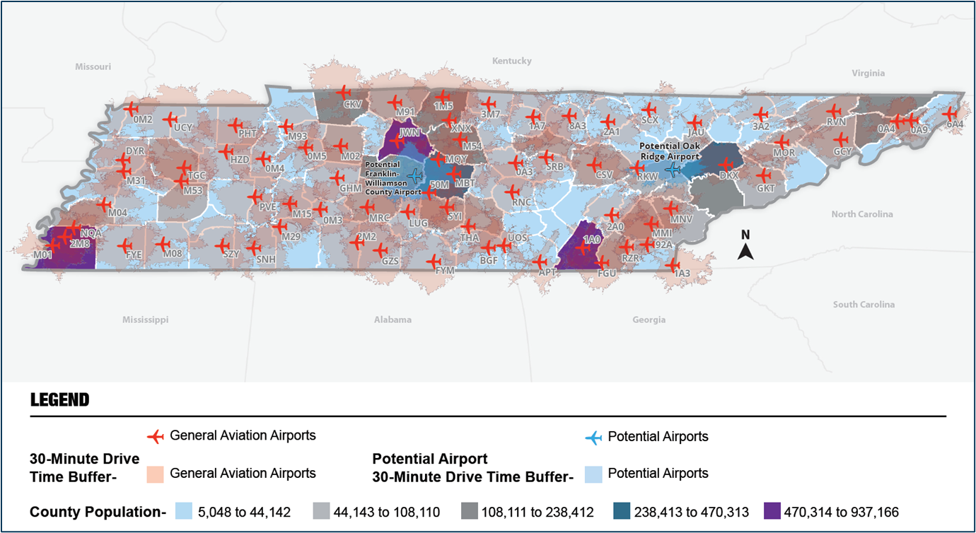
Potential Future General Aviation Airports

Slide 31
Goal #3 Performance Measure Example
Goal #3 – Safety and Security: Improve the safety and security of airport system users.
Performance Measure: Percent of airports that have adopted an emergency response and/or security plan.

Slide 32
Goal #3 Future System Performance Example
Goal #3 – Safety and Security: Improve the safety and security of airport system users.
Performance Measure: Percent of airports that have adopted an emergency response and/or security plan.
Airport Classification | Airports Meeting Objective | Proposed Future Performance | Airports Needed to Meet Performance
Commercial Service | 6 (100%) | 6 (100%) | 0 (0%)
Regional Service | 14 (82%) | 17 (100%) | 3 (18%)
Community Business | 10 (67%) | 15 (100%) | 5 (33%)
Community Service | 23 (61%) | 38 (100%) | 15 (39%)
Turf | N/A | No Target Established | N/A
Statewide | 53 (68%) | 76 (97%)¹ | 23 (29%)

Slide 33
Goal #4 Performance Measure Example
Goal #4 – Funding and Environment: Maximize federal, state, and local resources to meet airport system needs and minimize environmental impacts.
Performance Measure: Percent of airports with airport included in local comprehensive and/or land use plan.

Slide 34
Goal #4 Future System Performance Example
Goal #4 – Funding and Environment: Maximize federal, state, and local resources to meet airport system needs and minimize environmental impacts.
Performance Measure: Percent of airports with airport included in local comprehensive and/or land use plan.
Airport Classification | Airports Meeting Objective | Proposed Future Performance | Airports Needed to Meet Performance
Commercial Service | 4 (67%) | 6 (100%) | 2 (33%)
Regional Service | 8 (47%) | 17 (100%) | 9 (53%)
Community Business | 1 (7%) | 15 (100%) | 14 (93%)
Community Service | 7 (18%) | 38 (100%) | 31 (82%)
Turf | 0 (0%) | 2 (100%) | 2 (100%)
Statewide | 20 (26%) | 78 (100%) | 58 (74%)

Slide 35
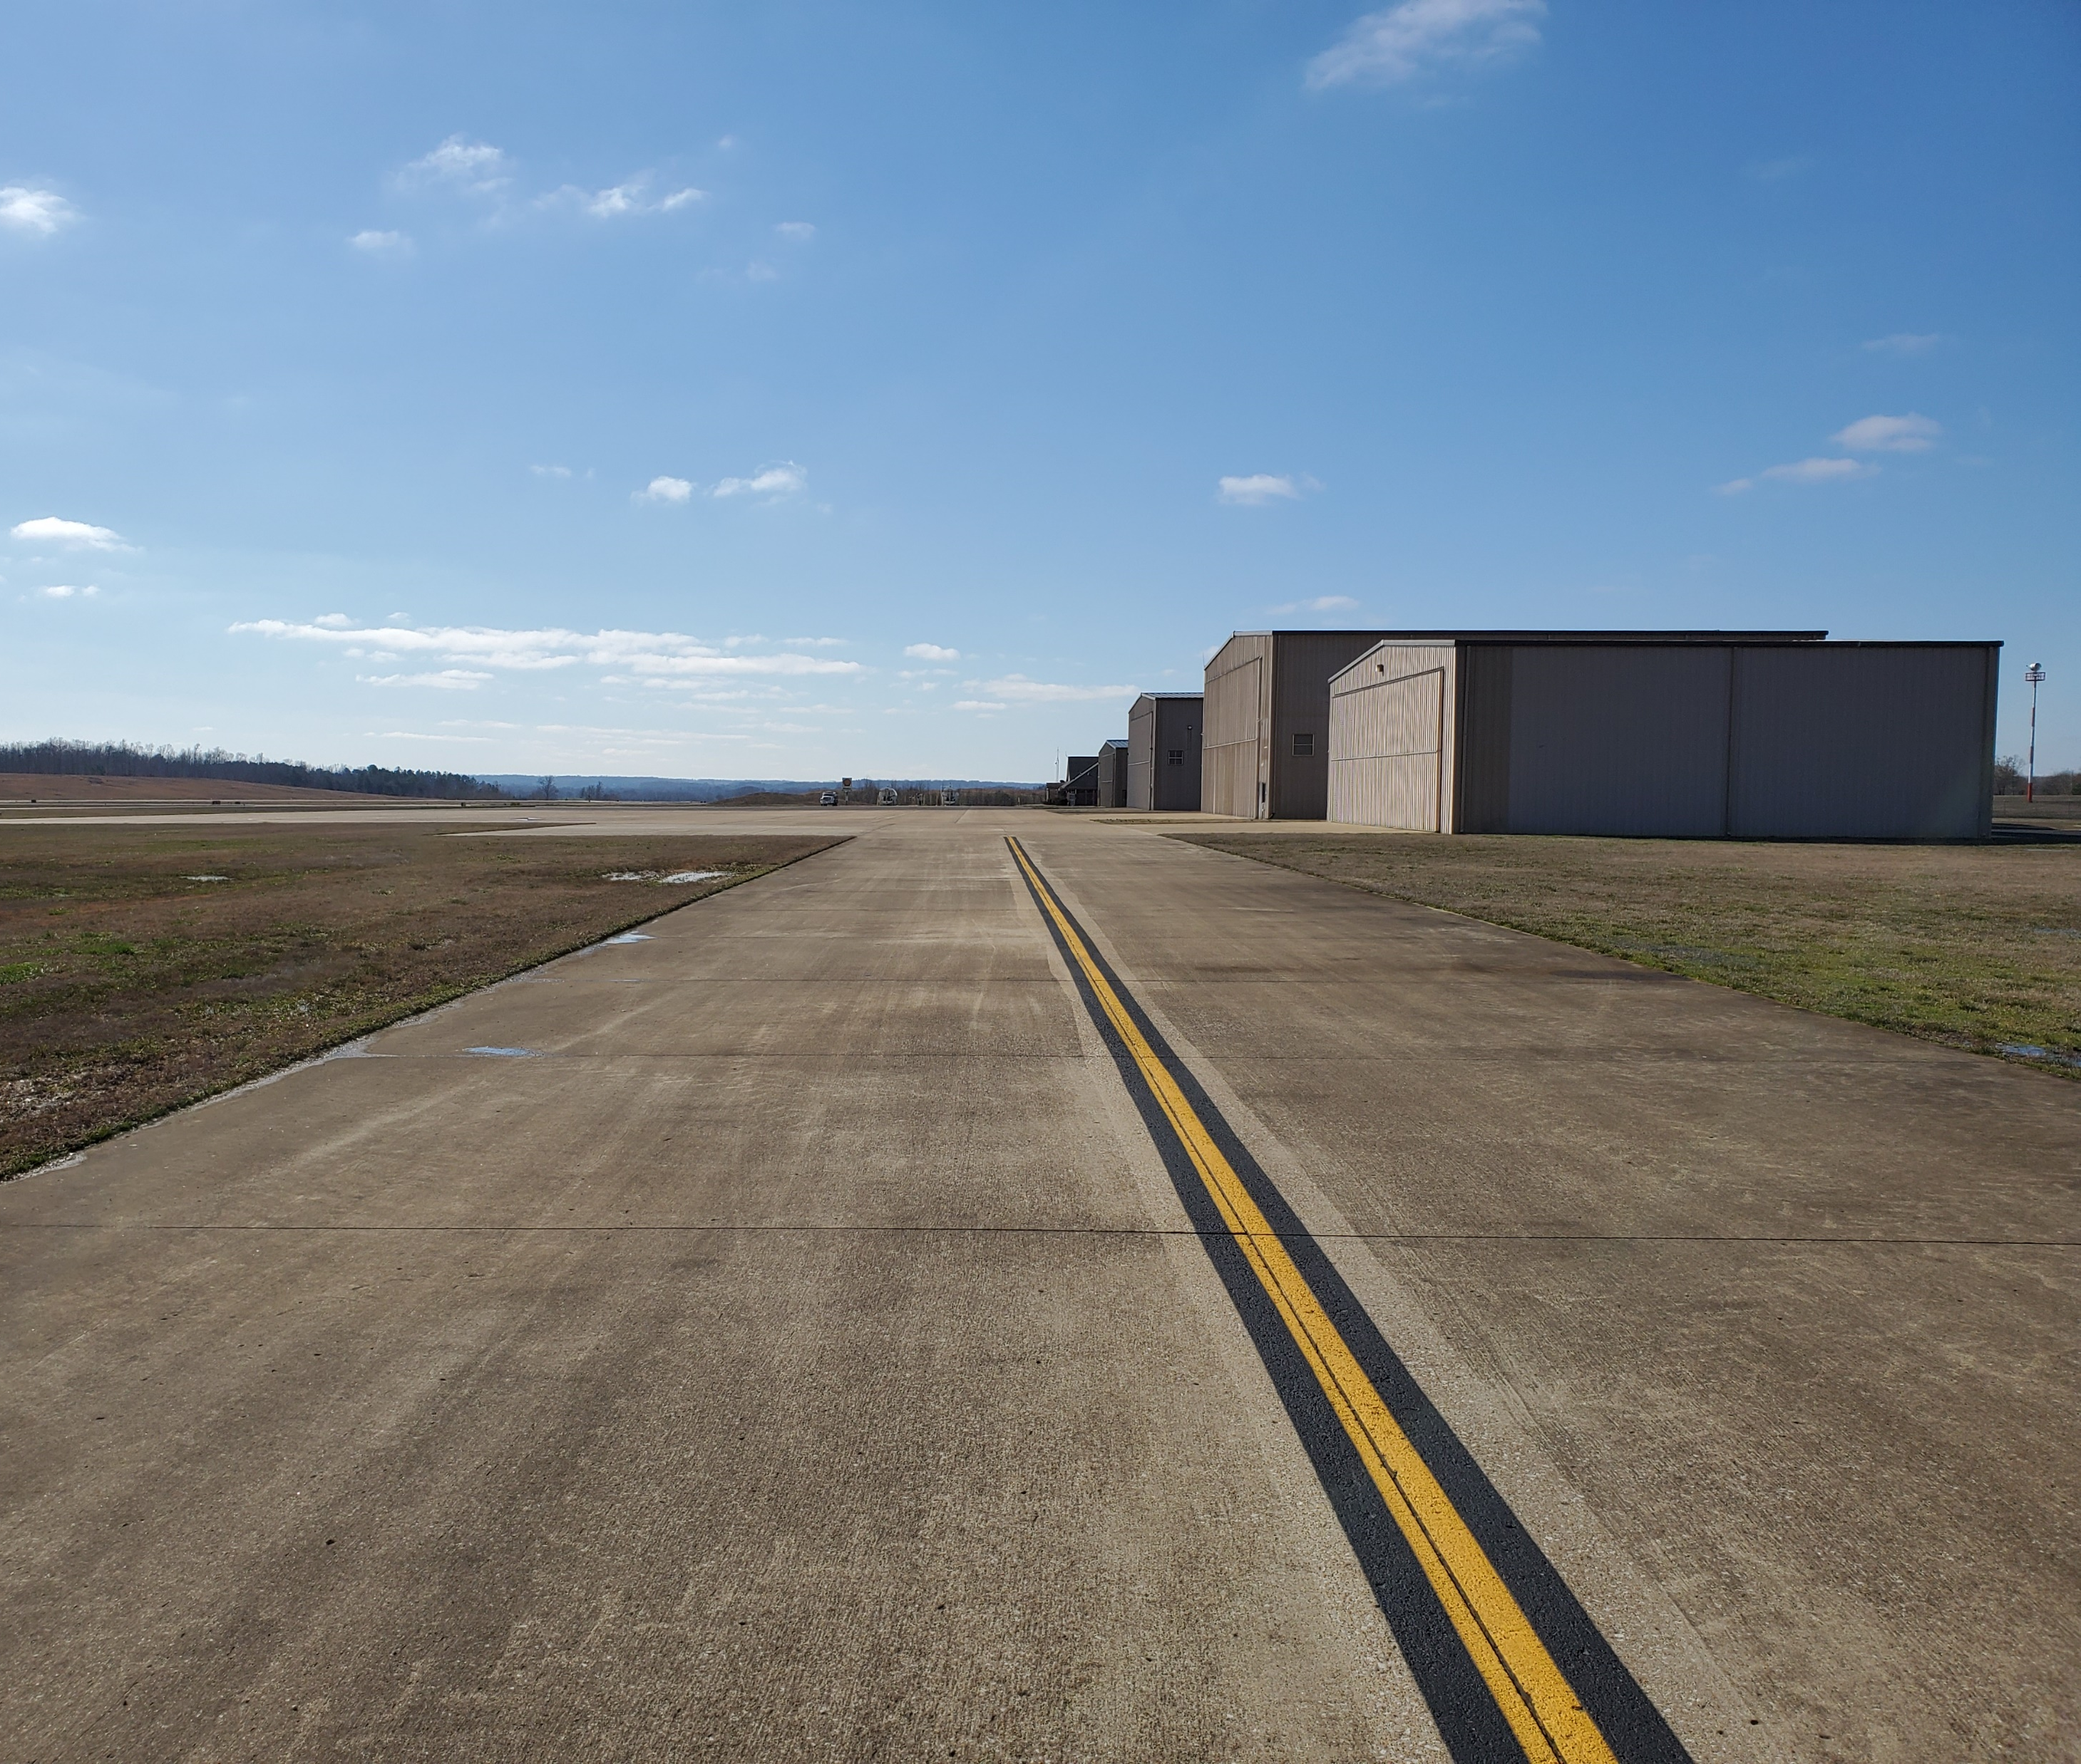
Goal #5 Performance Measure
Goal #5 – Workforce and Economy: Invest in the airport system and aviation workforce to support economic growth and competitiveness.
Performance Measure: Population and area within a 45-minute drive time of an airport meeting business aircraft needs.
91 percent of Tennessee’s population
65 percent of Tennessee’s total land area

Slide 36
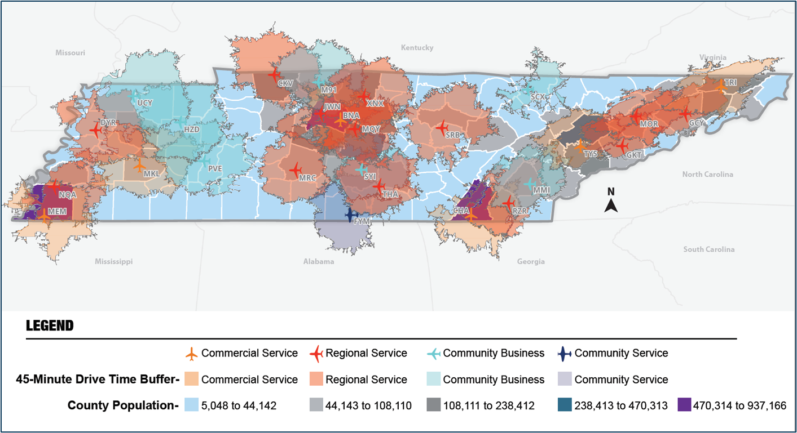
Population and area within a 45-minute drive time of an airport meeting business aircraft needs

Slide 37
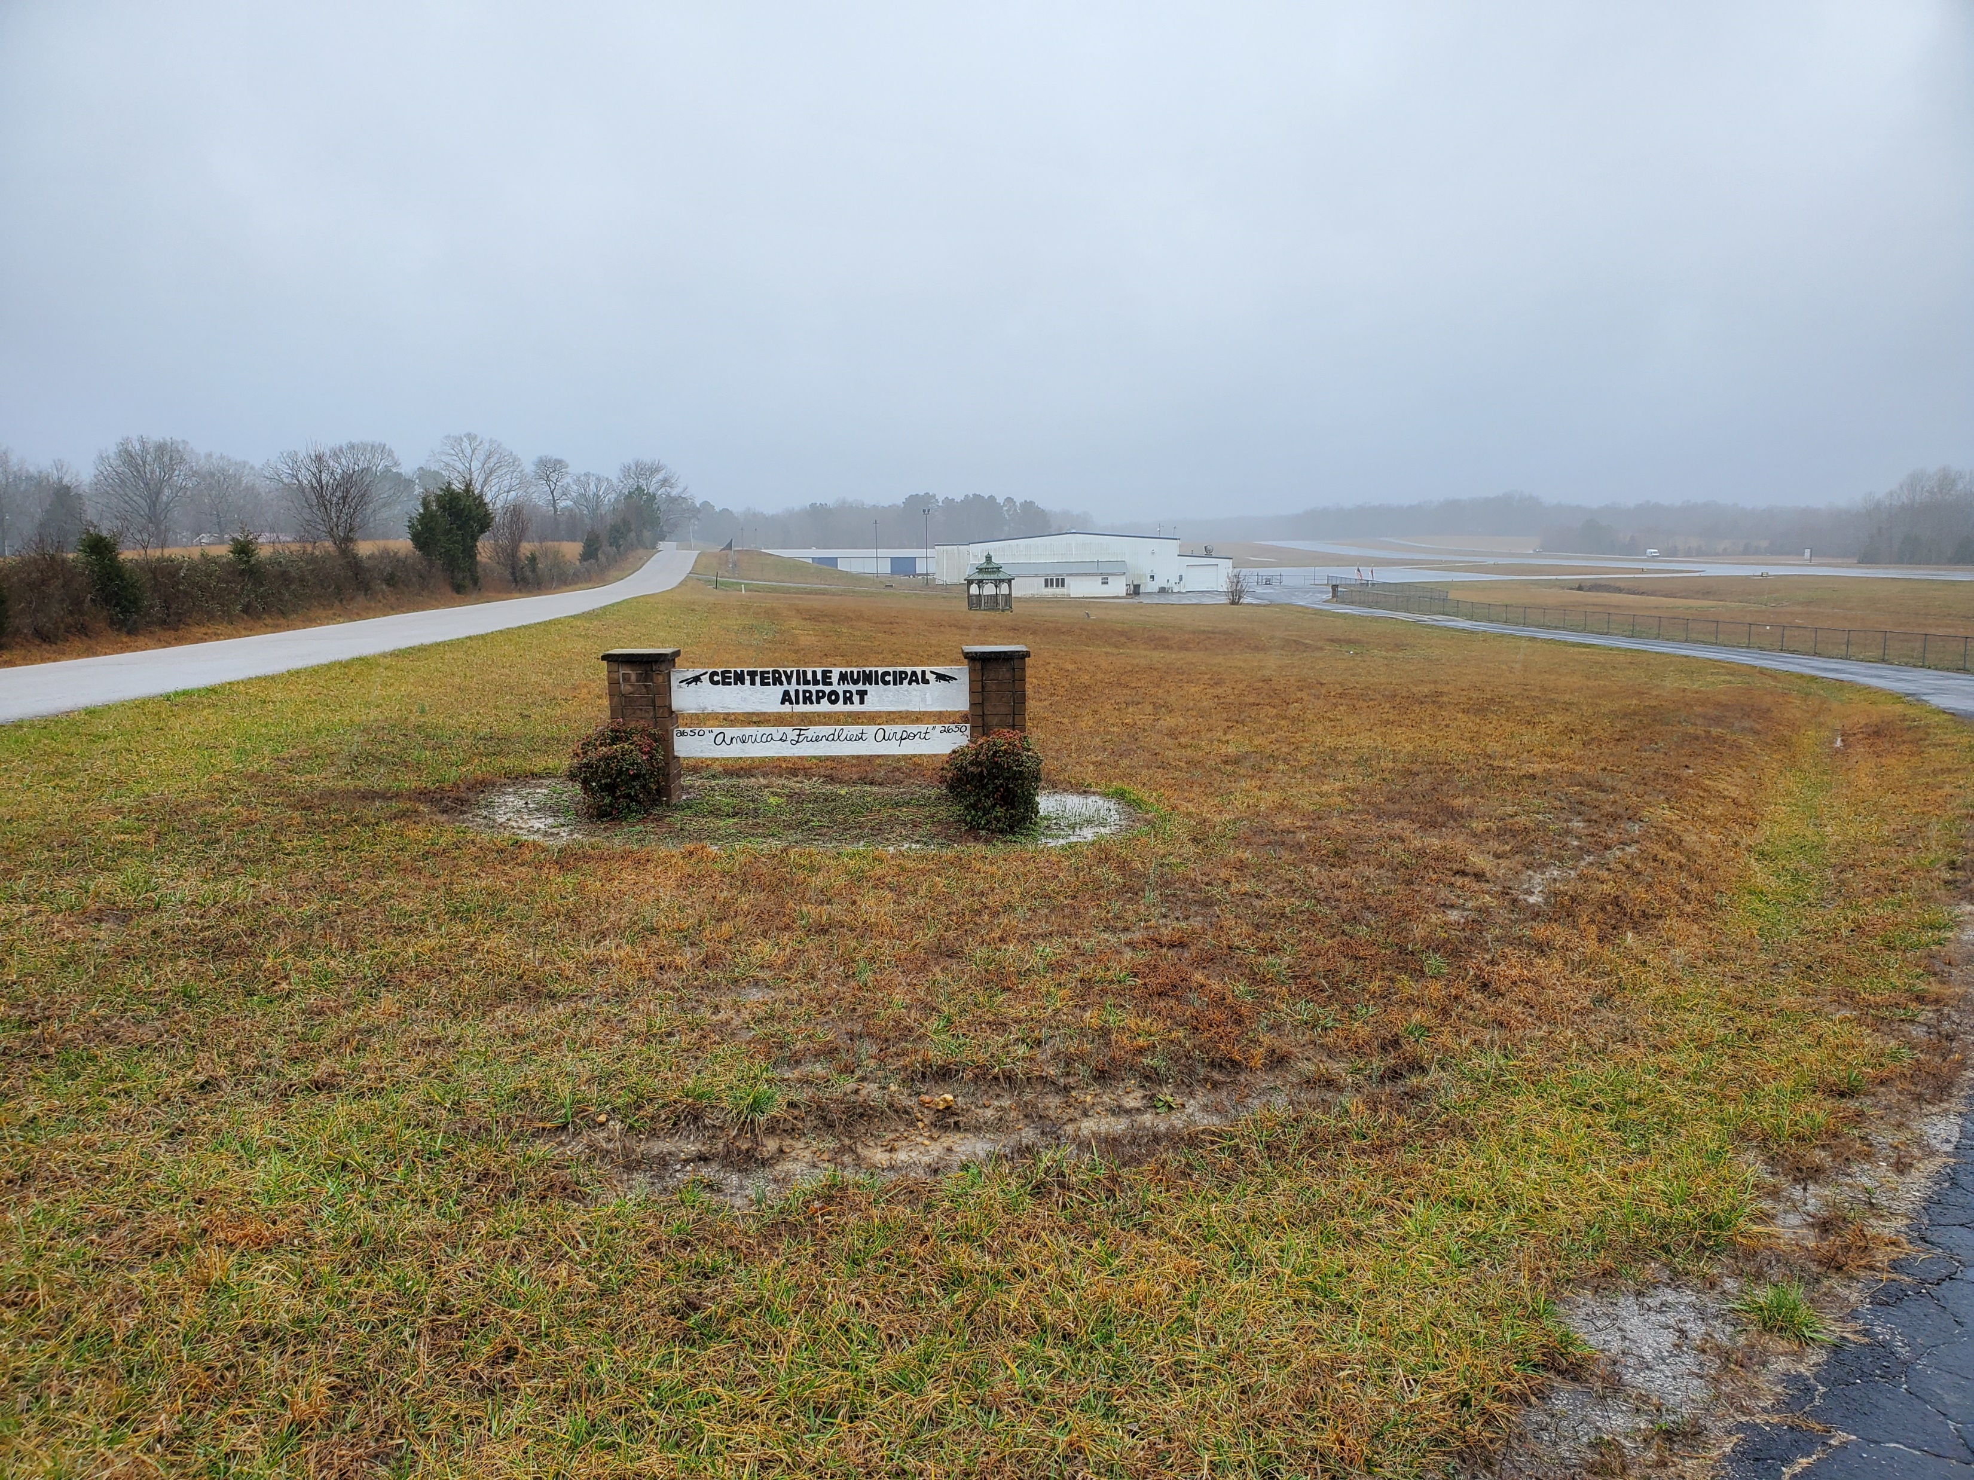
Goal #5 Future System Performance Example
Goal #5 – Workforce and Economy: Invest in the airport system and aviation workforce to support economic growth and competitiveness.
Performance Measure: Population and area within a 45-minute drive time of an airport meeting business aircraft needs.
Additional 2.2 percent of Tennessee’s population
Additional 4.4 percent of Tennessee’s total land area

Slide 38
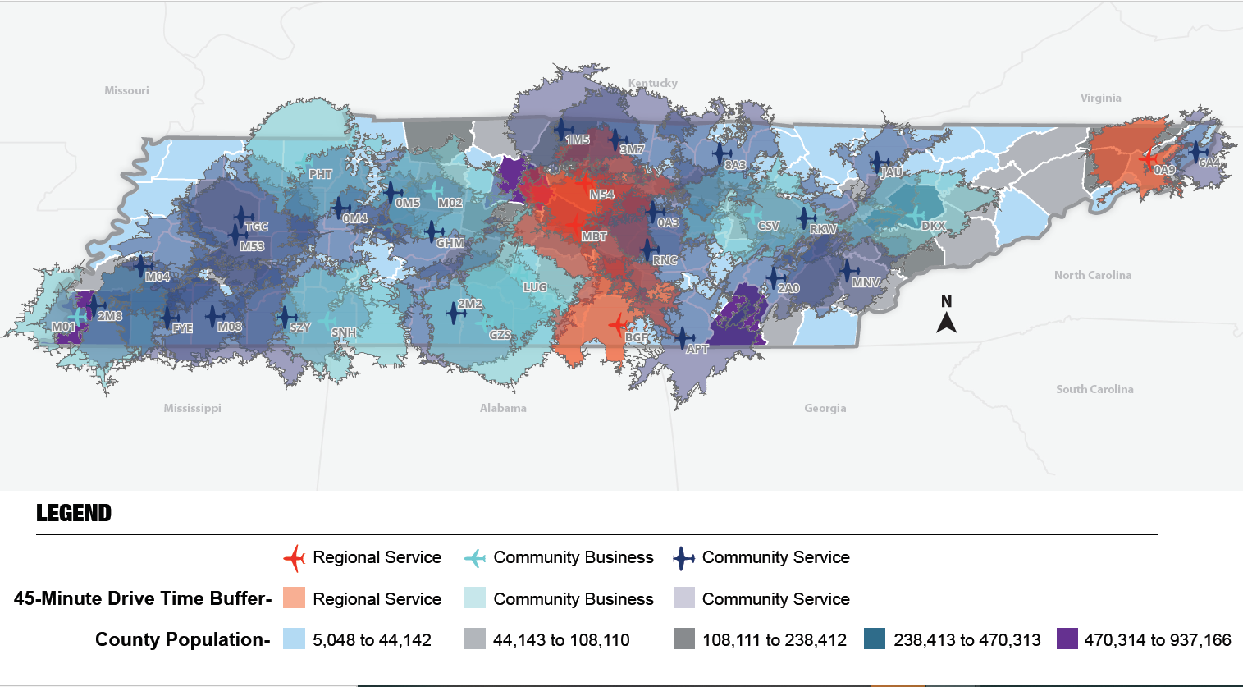
Potential Future Airports Meeting Business Aircraft Needs

Slide 39
Next Steps

Slide 40
Questions?
Evan Lester
TDOT Aeronautics Division Project Manager
615.361.8016
Evan.Lester@tn.gov
Zach DeVeau
Kimley-Horn Project Manager
850.553.3530
Zach.DeVeau@kimley-horn.com

