Slide 1
Crossville Memorial Airport –
Whitson Field
Economic Impact Presentation
TDOT Aeronautics Division
<INSERT DATE>
Notes:
The Tennessee Department of Transportation (TDOT) Aeronautics Division teamed with Kimley-Horn, EBP, and Garver, LLC to develop the Tennessee Aviation Economic Impact Study. The Tennessee Aviation Economic Impact Study was conducted in concert with the Tennessee Aviation System Plan (TASP). Both studies used data collected during or for Calendar Year 2019. For that reason, this study largely does not incorporate any impacts from the COVID-19 Pandemic, and presents the findings of Tennessee’s aviation system as of 2019.

Slide 2



What is an Airport Economic Impact Study?
Conveys the economic importance of airports and tells the story of how airports support and enhance the Tennessee economy
Notes:
This study quantified the economic contributions of aviation to individual airports, regions, and statewide; summarized the benefits that airports provide to residents and businesses; and developed case studies based on the unique contributions of various organizations in the state. The economic impact provides tools to inform and educate on the vast benefits of aviation in the state. Measures of economic impact and this airport’s individual economic impact findings will be provided in the later slides. Together, the analyses of the Tennessee Aviation Economic Impact Study provide a comprehensive assessment on the role and benefits of Tennessee’s airports, both in terms of numbers and telling the stories of the wide diversity of contributions that airports make to Tennessee.

Slide 3
Primary Objectives
IDENTIFY
On-Airport Impacts
Freight/Cargo Impacts
CALCULATE
Total Jobs
Payroll
QUANTIFY QUALIFY
Net Economic Contributions
Other Economic Impacts
(Case Studies)
Business Revenue
Value Added
Visitor Spending Impacts
Notes:
The primary objectives of the Tennessee Aviation Economic Impact Study (or EIS) were to identify the key components of aviation-related economic impacts, calculate impacts using the IMPLAN economic modeling software, and quantify the economic impacts of the Tennessee aviation system. This study evaluated quantitative data in terms of net economic contributions and developed case studies based on the unique contributions of aviation to the state, especially those that contribute to the quality of life of Tennesseans. This study used data collected from 2019 and as a result shows the findings from the system in 2019, without accounting for the effects of the COVID-19 pandemic.

Slide 4
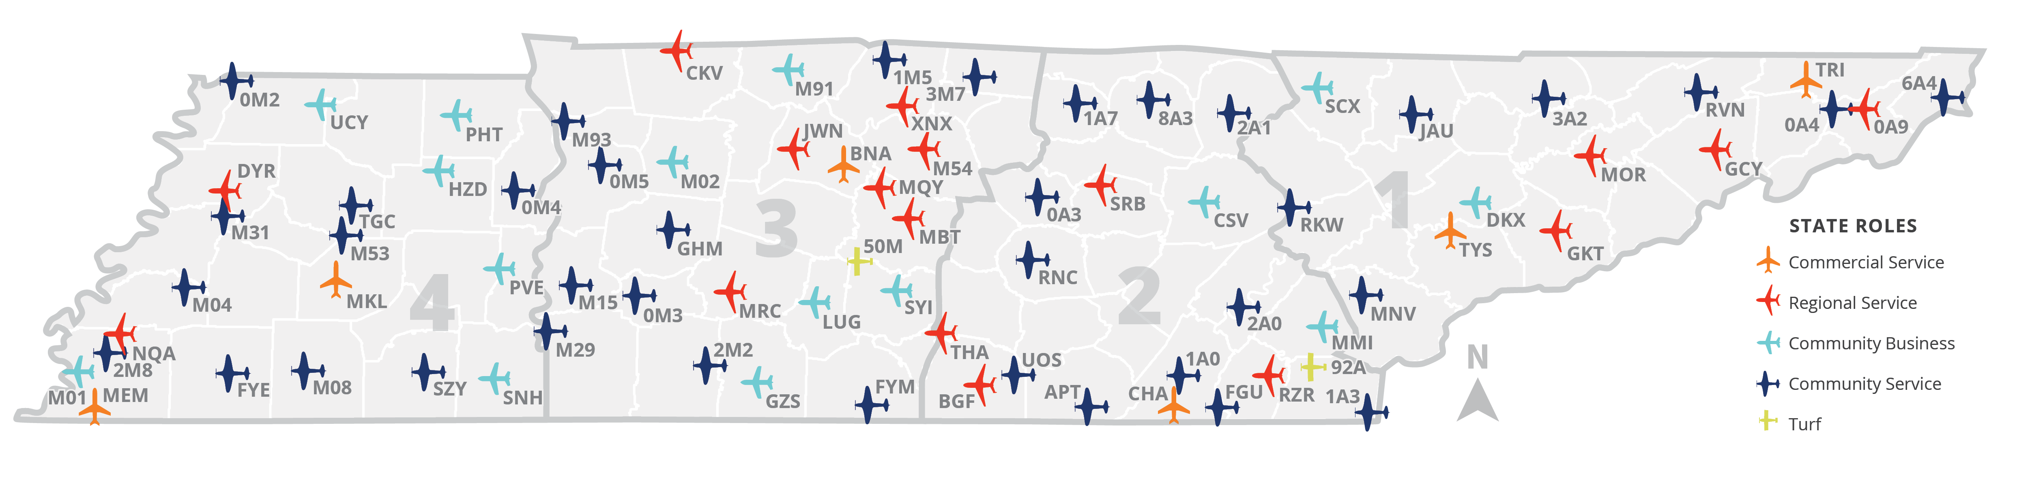
TDOT Regions and Study Airports
Notes:
The Tennessee Aviation Economic Impact Study studied 78 public-use airports across the state including:
74 publicly-owned airports
4 privately-owned airports
Of these 78 airports, six are Commercial Service and 72 are General Aviation (GA) airports.
The 4 regions of TDOT were used for the 2020 Tennessee Aviation Economic Impact Study. Supplier purchases and income re-spending are modeled at both a regional and statewide scale to allow for presentations of regional and statewide impacts for each airport, as well as statewide impacts for the Tennessee airport system. Regional impacts of airports consist of the direct impacts plus regional multiplier impacts. These regional multiplier impacts are how money is re-spent within the region and the supplier purchases also only in that region. Statewide impacts are the same direct impacts plus multiplier effects that reflect an airport’s spending and impact throughout all of Tennessee.

Slide 5
Methodology
Overview

Slide 6

Economic Impact Categories
Category | Meaning
On-Airport Activity | Impacts related to the activity of airport administration, business tenants, and capital improvements on airports
Visitor Spending | Impacts related to out-of-state visitor spending at both commercial service and general aviation airports
Freight/Cargo Activity | Impacts related to air cargo operations; available only at the regional or statewide level
Notes:
There are three categories that are used to describe economic impacts and derive the total impacts by airport, region, and for the state. This table presents the three categories used in the 2020 Tennessee Aviation Economic Impact Study including a definition of each. When the total economic impacts are presented, they represent the summation of the on-airport activity, visitor spending, and freight/cargo activity at each level. As a note, freight/cargo activity is an off-airport air cargo analysis that assesses the reliance of off-airport industries in Tennessee on cargo that is transported through Tennessee airports and calculates the economic contributions of this air cargo to off-airport businesses on both the statewide and regional bases. This analysis does not include the impacts of on-airport air cargo jobs, which are covered by other components of the Economic Impact Study.

Slide 7
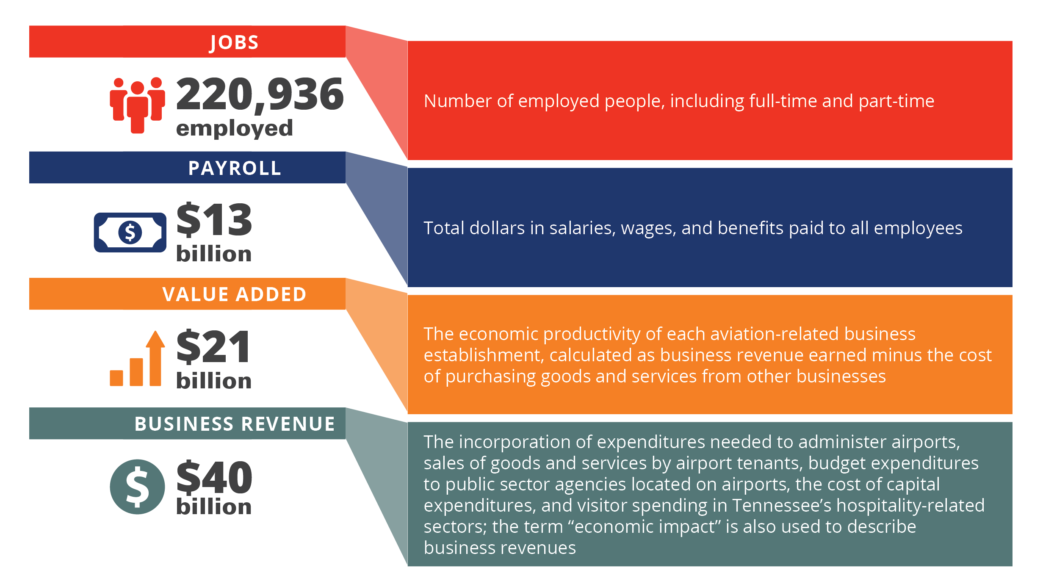
Economic Impact Measures
Jobs: Number of employed people, including full-time and part-time
Payroll: Total dollars in salaries, wages, and benefits paid to all employees
Value Added: The economic productivity of each aviation-related business establishment, calculated as business revenue earned minus the cost of purchasing goods and services from other businesses
Business Revenue: The incorporation of expenditures needed to administer airports, sales of goods and services by airport tenants, budget expenditures to public sector agencies located on airports, the cost of capital expenditures, and out-of-state visitor spending in Tennessee’s hospitality-related sectors; the term “economic impact” is also used to describe business revenue
Notes:
The economic impact of airports are expressed in terms of jobs, payroll, value added, and business revenue. These metrics cannot be added to one another, as value added encompasses payroll, and business revenue encompasses value added and payroll.

Slide 8
Economic Impact Terms
EIS Term | Meaning | Economic Term
Direct | Initial effects that occur on- and off-airport, by spending from visitors and by companies using air transportation services | Direct
Supplier Sales | Portions of direct revenues used to purchase goods and services from Tennessee businesses | Multiplier
Income Re-spending | Income earned by workers from direct and supplier sales transactions that are then spent in Tennessee (household spending) | Multiplier
Notes:
There are three terms that are used to describe economic impacts and derive the total impacts by airport, region, and for the state. This table presents the three terms used in the Tennessee Aviation Economic Impact Study with their meaning and the economic industry term for reference. Direct impacts create both supplier sales and income re-spending. When the total economic impacts are presented, they represent the summation of the direct, supplier sales, and income re-spending effects. When examined on the regional level, the supplier sales and income re-spending are those that occur in the region compared to the state level which identifies the impacts associated with supplier sales and income re-spending of the direct impacts throughout the state.

Slide 9
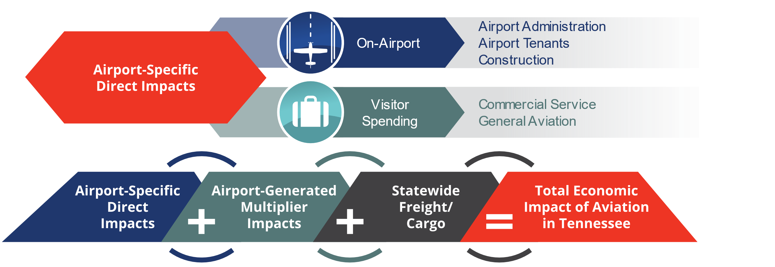
Calculating Total Impacts
Notes:
The total economic impact of airports is the sum of direct impacts, multiplier impacts (both supplier sales and income re-spending), and statewide freight/cargo, the results of which are expressed in terms of jobs, payroll, value added, and business revenue. Direct impacts are generated by two main streams: on-airport business activity and out-of-state visitor spending. Both streams are analyzed at the airport-specific level. Multiplier impacts are generated as a result of direct impacts. Freight/cargo is analyzed at the statewide and regional levels, and is done at an industry level, not company level. On-airport activity, visitor spending, and off-airport freight/cargo impacts are described in more detail in the following slides.

Slide 10

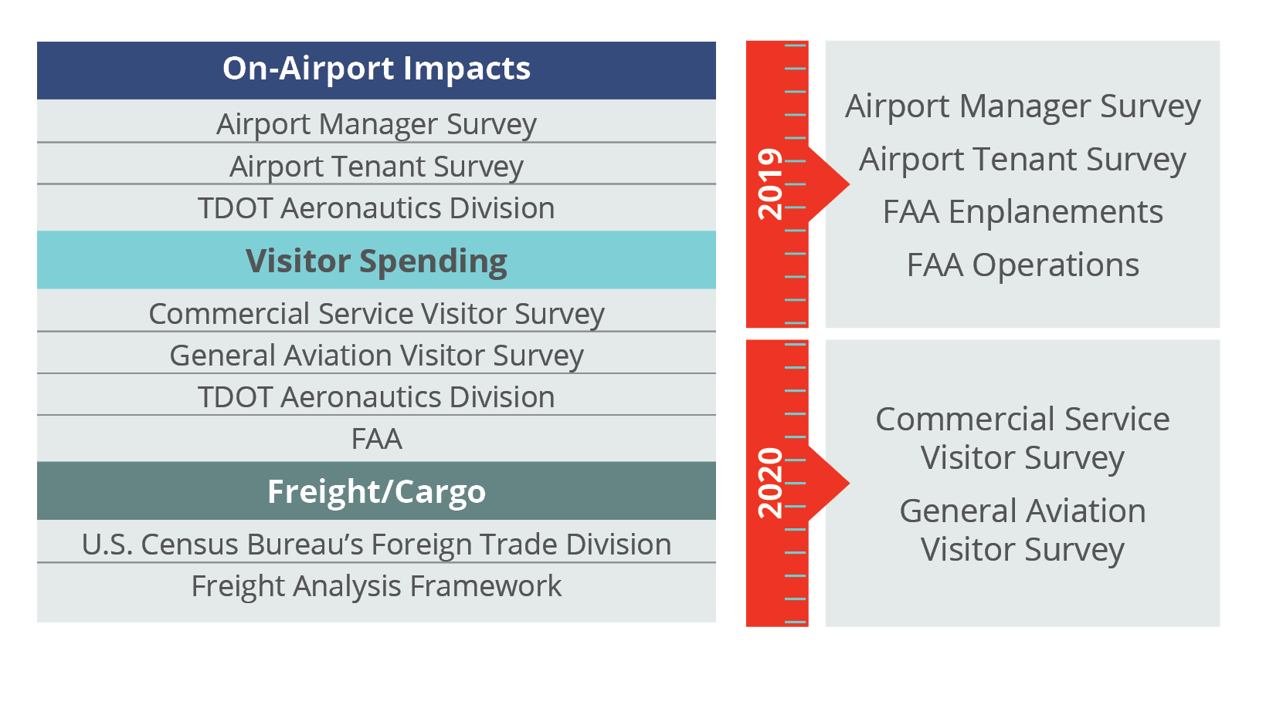
Data Sources
Study Data
Sources
Study Data
Source Years
Notes:
The primary data source for this economic impact study was a series of surveys designed to gather key information for activities generating direct on- and off-airport economic activity. When necessary, additional secondary data, including the IMPLAN modeling system, were used to fill in any missing information from the surveys for on- and off-airport business activity and visitor spending.
Data were primarily gathered in 2019, specifically survey data (including employment and payroll data), enplanements, and operations. Due to the timing of the study, commercial service visitor surveys were collected in 2020, during the COVID-19 pandemic. Commercial service and general aviation visitor results were adjusted to 2019 levels in order to be analyzed along with other data collected in 2019. In all, data collected for this study accounted for 2019 activity levels and do not take into account the effects of the COVID-19 pandemic.

Slide 11
Overview of Economic Impact Categories
Notes:
The following sections provide an overview and explanation of the different categories of economic impact, including on-airport activity, visitor spending, and freight/cargo impacts

Slide 12
On-Airport Activity
Airport Administration
Airport operations, management, and budget including but not limited to facility and grounds maintenance and other administrative needs.
Airport Tenants
Airlines; fixed-base operators (FBOs); maintenance, repair, and overhaul (MRO) providers; aircraft service companies, terminal concessionaires; and other businesses with employees working on-airport property.
Capital Improvements
Construction of airside and landside facilities involving airport (local), federal, state, and other funds, as well as tenant expenditures. Total annual expenditures between 2016 – 2019 were averaged to obtain an “average” expenditure year.
Notes:
On-airport impacts are generated by activities conducted by airport administration including owners, managers, and sponsors, on-airport business tenants with employees working on airport property, and capital improvement expenditures. To ensure the study results are more representative of average capital spending impacts, the amount of capital improvements over multiple years are averaged to “smooth out” any years of particularly high or low expenditures to create a profile of an “average” spending year. Additional expenditures were gathered through the airport tenant survey, in which tenants were asked if they had paid for capital improvements such as building out concession space or constructing a hangar. IMPLAN regional relationships between construction revenues and jobs, payroll, and value added were used to develop the full profile of direct impacts resulting from capital expenditures on construction.

Slide 13




Visitor Spending
Visitors (Commercial and GA Spending)
Airports facilitate money from out-of-state being brought into Tennessee. Impacts are generated by non-local visitors who arrive by air and spend money off-airport on lodging, retail, restaurants, entertainment, and local transportation.
Notes:
Air visitors arrived by scheduled airline service through one of Tennessee’s commercial service airports with service in 2019 and by GA aircraft at all 78 study airports. The visitor spending analysis looks specifically at visitors to Tennessee from out of state or international locations, as these travelers bring new money into the state’s economy. The analysis also removes transit passengers who connect through a Tennessee airport on their way to another final destination.
Spending estimates for visitors using commercial or GA airports were developed through information obtained from airport passenger surveys as well as third-party data providers (such as local/state tourism agencies).

Slide 14
Off-Airport Freight/Cargo Impacts
Analysis documents off-airport impacts supported by air cargo services at airports
  The impacts of FedEx, UPS, and other air cargo carriers on airports are included in individual airport economic impacts
Analysis relies on data from a variety of sources
Top industries reliant on air cargo include precision instruments and electronics
Notes:
In addition to individual airport economic impacts, the economic impact of cargo/freight analysis quantifies the off-airport activities supported by air cargo services at Tennessee’s airports. Cargo/freight’s “off-airport-related impacts” are the business revenue earned due to these long-distance sales, and the subsequent jobs, payroll, and value added attributable to those sales. These impacts are earned by a wide range of manufacturing, agricultural, and other companies who rely on Tennessee’s airports to ship products out-of-state.
The analysis used data from several sources regarding air cargo freight and industry sector relationships, including: the U.S. Census Bureau’s Foreign Trade Division (collected by WISERTrade) and the Freight Analysis Framework (FAF), as well as county-level economic output by industry sectors, assembled by IMPLAN from federal sources (primarily the U.S. Bureau of Economic Analysis [BEA]). The analysis showed that the top Tennessee industries that are reliant on air cargo include precision instruments and electronics which rely on air cargo transport outside of Tennessee and generate additional economic impacts not quantified at the airport level.

Slide 15
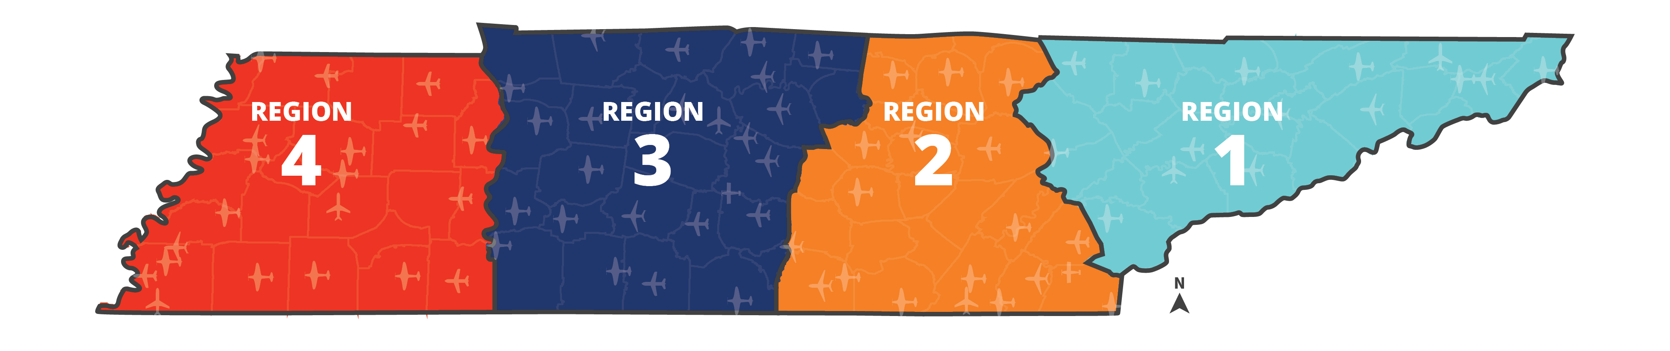



Off-Airport Freight/Cargo Impacts
$4.7
billion
$7.8
billion
$2.6
billion
$4.2
billion
Over 82,000
Off-Airport Jobs
$19 Billion
in Business Revenue
Notes:
The results of the off-airport cargo/freight analysis show that, overall, air cargo services at Tennessee airports support over 82,000 off-airport jobs in the state and generate more than $19 billion in business revenue. The jobs and business revenue attributable to off-airport air cargo are separate from the jobs and business revenue supported by on-airport air cargo companies. These companies contribute to an individual airport’s economic impact to the state, whereas off-airport cargo/freight economic impacts are calculated on a regional and statewide basis.
This figure shows the breakdown of cargo impacts by region; these impacts are based on the locations of industries that rely on air cargo and not the location of airports.

Slide 16
Economic
Impact Results
Notes:
The following section summarizes the economic impacts by type of economic impact expressed in terms of jobs, payroll, value added, and business revenue.

Slide 17
TOTAL Statewide Aviation Impacts
JOBS
PAYROLL
VALUE ADDED
BUSINESS REVENUE
220,936
employed
$13 billion
$21 billion
$40 billion
Including off-airport air cargo impacts of $19 billion
Notes:
At the statewide level, the 78 Tennessee airports support 220,936 jobs earning $13 billion in payroll, contribute $21 billion in value added, and generate a total economic output of $40 billion. This includes a total off-airport cargo/freight impact of $19 billion.

Slide 18
TOTAL Region 2 Impacts
JOBS
PAYROLL
VALUE ADDED
BUSINESS REVENUE
18,087
employed
$1.0
billion
$1.6
billion
$3.5 billion
Notes:
Region 2 created 18,087 jobs earning $1.0 billion in payroll, contributed $1.6 billion in value added, and generated a total economic output of $3.5 billion.

Slide 19
TOTAL Crossville Memorial Airport –
Whitson Field Impacts
JOBS
PAYROLL
VALUE ADDED
BUSINESS REVENUE
43
employed
$2.3
million
$3.1
million
$6.0 million
Notes:
Crossville Memorial Airport – Whitson Field created 43 jobs earning $2.3 million in payroll, contributed $3.1 million in value added, and generated a total economic output of $6.0 million.

Slide 20
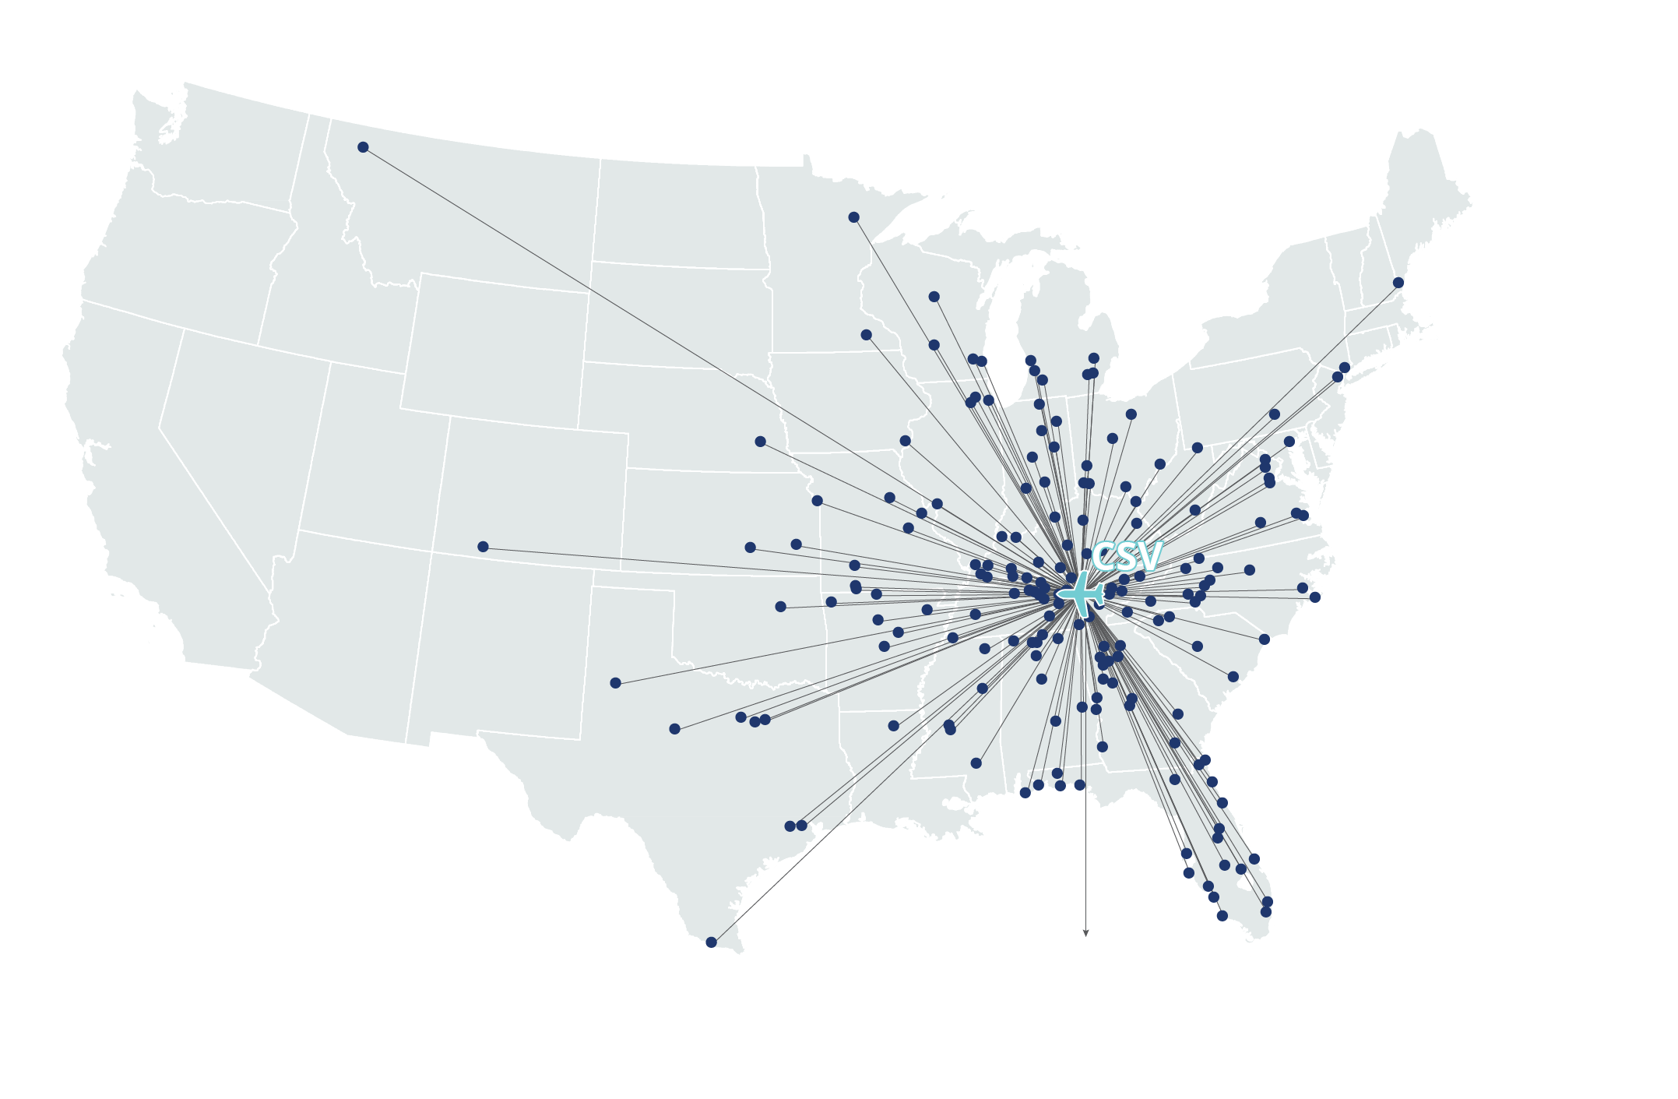
Think Crossville Memorial Airport –
Whitson Field Is Just Local?

Slide 21
Crossville Memorial Airport – Whitson Field
Economic Impacts - Jobs
Impact Category | Direct | Supplier Sales | Income Re-spending | Total Jobs
Total Jobs | 23 | 9 | 11 | 43
Notes:
The following slides present the individual components of economic impacts of Crossville Memorial Airport – Whitson Field. As this slide shows, Crossville Memorial Airport – Whitson Field supports 43 total jobs generated by on-airport activity and out-of-state visitor spending. The sum may not equal the total due to rounding.

Slide 22
Crossville Memorial Airport – Whitson Field
Economic Impacts – Payroll
Impact Category | Direct | Supplier Sales | Income Re-spending | Total Payroll
Total Payroll | $1,200,000 | $511,000 | $540,000 | $2,300,000
Notes:
Crossville Memorial Airport – Whitson Field generates $2.3 million in payroll due to on-airport activity and visitor spending. The sum may not equal the total due to rounding.

Slide 23
Crossville Memorial Airport – Whitson Field
Economic Impacts – Value Added
Impact Category | Direct | Supplier Sales | Income Re-spending | Total Value Added
Total Value Added | $1,500,000 | $724,000 | $923,000 | $3,100,000
Notes:
Crossville Memorial Airport – Whitson Field contributes $3.1 million in value added. The sum may not equal the total due to rounding.

Slide 24
Crossville Memorial Airport – Whitson Field
Economic Impacts – Business Revenue
Impact Category | Direct | Supplier Sales | Income Re-spending | Total Business Revenue
Total Business Revenue | $3,000,000 | $1,400,000 | $1,600,000 | $6,000,000
Notes:
Crossville Memorial Airport – Whitson Field contributes $6 million in business revenue generated by on-airport activity and visitor spending. This metric encompasses payroll and valued added and thus represents the total economic output of Crossville Memorial Airport – Whitson Field. The sum may not equal the total due to rounding.

Slide 25

Tax Analysis
Aviation Activities Subject to Taxes
On-Airport Activities
Fuel Sales
Rental Cars
Retail
Restaurants
Liquor
Services
Construction
Visitors
Retail Sales
Lodging
Food and Beverage
Entertainment
Recreation
Local Transportation
Employees
Airport Administration
On-Airport Businesses
Construction
Visitor Support Businesses
Off-Airport
Cargo/Freight
Notes:
Airports also generate tax revenues to state and local governments from:
Direct activities at commercial service and GA airports
First-round spending by visitors
Multiple rounds of spending generated by supplier sales and income re-spending result in additional revenues to taxing authorities; however, this analysis only looked at direct impacts.

Slide 26

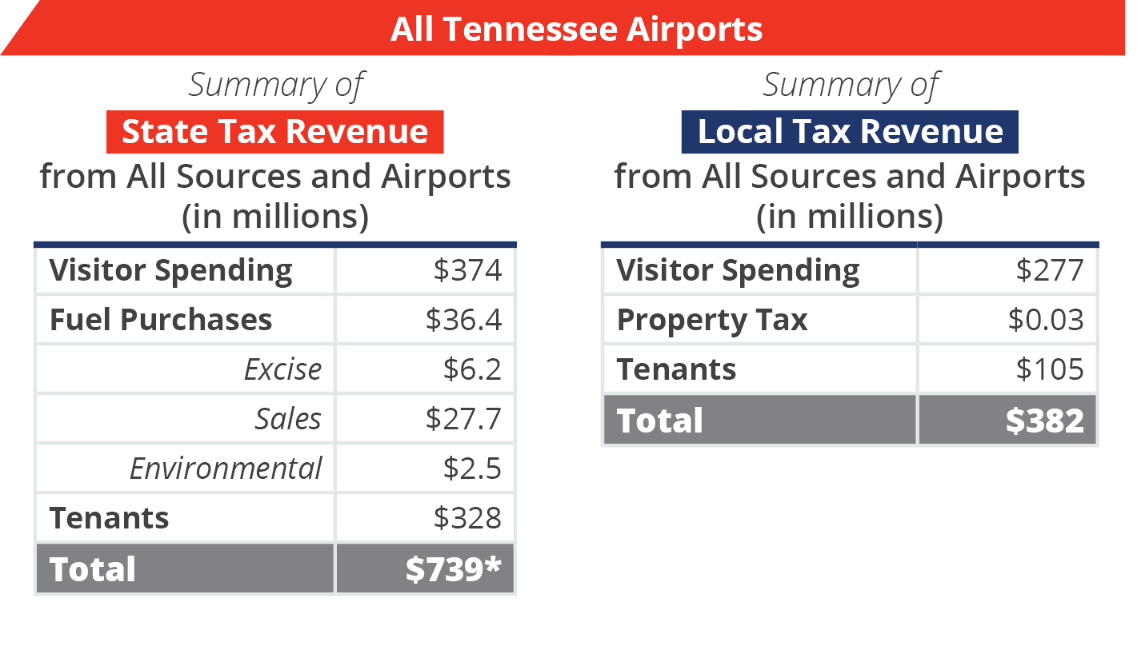

Statewide Tax Impacts
Total state and local tax revenue from direct airport impacts equals almost $1.12 billion.
Notes:
Tax impacts are a sub-component of on-airport and visitor spending impacts.
Local and state taxes attributable to Tennessee’s airports come from a variety of sources. For example, users purchase aviation fuel subject to an aviation fuel tax, and airport tenants collect sales taxes on goods sold directly to customers. Based on data collected from the Tax Foundation; the U.S. Bureau of Economic Analysis; and other federal, state, and local sources, tax impacts attributable to Tennessee’s airports were calculated to be $739 million of State tax revenue and $382 million Local tax revenue for a total tax revenue of $1.12 billion in 2019.

Slide 27
Additional
Aviation Benefits
Notes:
The following section provides additional aviation benefits that are not quantified in the previous slides.

Slide 28
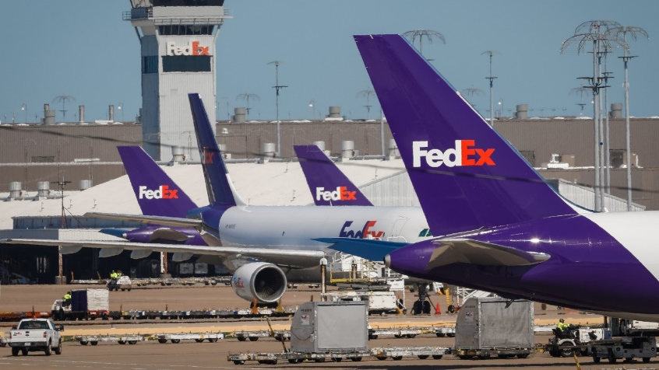


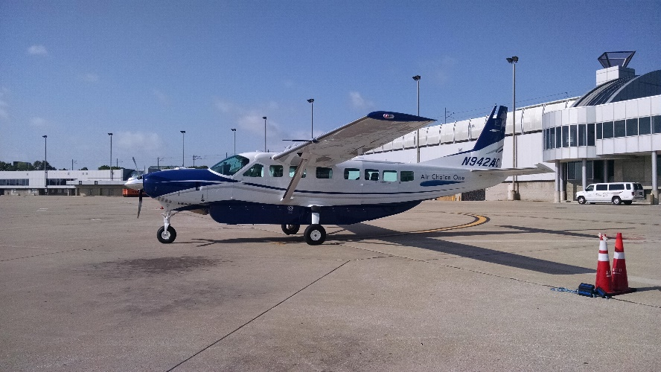
Case
Studies
Notes:
Airports contribute to Tennessee’s quality of life, safety, security, and resiliency in ways that can never be captured in dollars. The 2020 Tennessee Aviation Economic Impact Study and Tennessee Aviation System Plan (TASP) identified 10 case studies of how unique aviation programs, organizations, and activities support residents of Tennessee and aviation users around the globe. These are documented in stories summarized by topic, as well as throughout the Tennessee Aviation Economic Impact Study and TASP technical reports.

Slide 29
Crossville Memorial Airport – Whitson Field
Users/Stories
Picture Placeholder
Notes:
Airport to tailor to their specific users/stories.

Slide 30
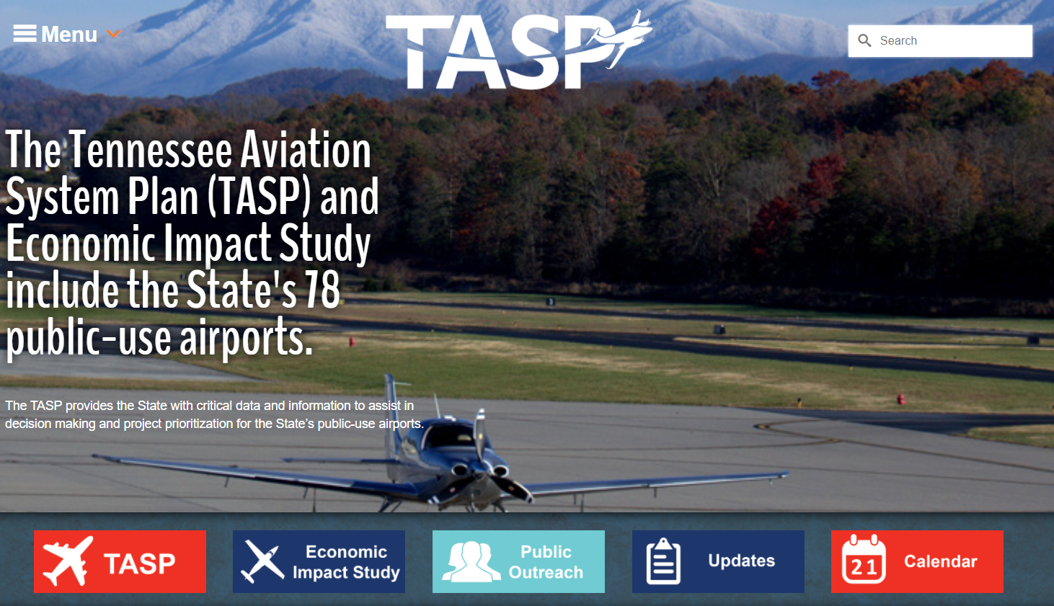
Project Website
tasp2040.com
Notes:
The final study documents for both the 2020 Tennessee Aviation Economic Impact Study and Tennessee Aviation System Plan are available online at www.tasp2040.com. The website also includes individual airport brochures that can be downloaded for all airports included in the scope of the study.

Slide 31
Contact
Evan Lester
TDOT Aeronautics Division
TASP and Aviation Economic Impact Study
Project Manager
615.361.8016 | Evan.Lester@tn.gov
Michelle Frazier
TDOT Aeronautics Division
Division Director
615.741.3208 | Michelle.Frazier@tn.gov
CSV Presenter Name
Role
Phone | Email

